Slide 1
Biotechnology and Genetically Modified Crops

Slide 2
Presenter Notes
Thank you for communicating modern agriculture.
Customize this presentation for your audience. Insert your brand logo, contact information, re-arrange slides, and so forth. Please contact ScientificResources@bayer.com with questions or further context about the slide content.
Looking for ag resources? Bayer Crop Science Resource Library

Slide 3
Biotechnology Is Used in
Many Common Products
Enzymes
Yeast
Medicine
Nearly all cheese is made using rennet produced through biotechnology
Scientists use biotechnology to create unique yeast strains for use in brewing beer and making bread
Most insulin used by diabetics is produced through biotechnology
Notes:
There is a lot of discussion around GMO seeds for crops. GMOs are used for a wide range of products people depend on every day.
Biotechnology, the process by which GMOs are created, is used in production of rennet, which is used in making cheese. Prior to biotech solutions, these enzymes were extracted from the stomachs of cows. The fourth stomach, to be exact. Naturally occurring rennet often contained impurities that could result in less-than-ideal conditions. Biotech has enabled production of more predictable rennet that helps cheese-makers deliver the flavors and consistency that consumers expect.
Biotech also helps in the production of yeast used for bread and beer. Again, biotech helps to provide a more precise product that delivers the flavor profile that a baker or brewer is seeking. You don’t want a Doppelbock that tastes like an ESB, after all.
We also depend on biotechnology for production of life-saving medications, most notably, insulin. Prior to biotech solutions, insulin was extracted from the pancreas of a pig or cow. Prior to that, it was extracted from human cadavers.
I think that this understanding of the history of GMOs, what they are and how they’re used, helps put a lot of the current discussion into better perspective. A lot of people aren’t aware of how broadly the technology is used, of the many benefits it provides, how long it’s been around and how extensively it’s been tested.

Slide 4
Plant Biotechnology Is an Extension of Traditional Plant Breeding
Traditional Plant Breeding
Desired
Gene
Many Genes are
Transferred
Plant Biotechnology
Desired
Gene
Desired
Gene
Only Selected Gene
is Transferred
“GMO”
Notes:
This chart illustrates the precision of biotechnology versus breeding. With traditional breeding, we can introduce a desirable trait from a parent to offspring, but there’s a good chance that other traits will be transferred as well, since hundreds of genes are being crossed. Those additional traits might be desirable, or they might not. That’s where a lot of trial and error is involved. It can take multiple generations of bred plants to produce the seed that delivers a desirable trait without other drawbacks.
Mapping of the genome has allowed us to be much more precise in breeding techniques — we can identify which genetic keys result in desirable traits, and introduce those traits into seeds. This more precise science allows plant breeders to develop crops with specific beneficial traits and without undesirable traits, such as those that would reduce food production.
Taking some of the mystery out of GMOs is certainly a good start to addressing safety questions. But how do we know for certain that these products are safe? Compositional analysis is used to:
Assess the nutritional status of the resultant food/feed (nutrients, anti-nutrients, toxicants, appropriate secondary metabolites) i.e. substantial equivalence to its conventional counterpart. Regulatory agencies in 70 countries review the safety.

Slide 5
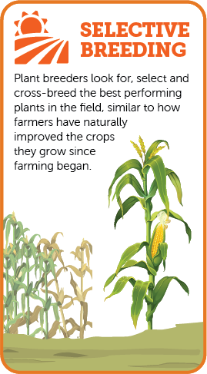
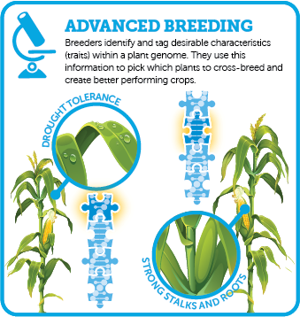
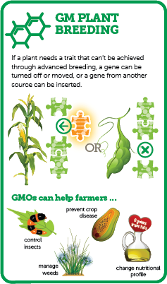
Ways to Have Better Harvests
GMOs are the product of a specific type of plant breeding where precise changes are made to a plant’s DNA to give it characteristics that cannot be achieved through traditional plant breeding methods.
Source: GMOAnswers.com https://gmoanswers.com/sites/default/files/WhatIsGMO_Infographic_1224x792px-Jan2018_0.jpg
Source: http://croplife.org/biotech-crop-development/
Notes:
There are several ways that plants can be improved: selective breeding, advanced breeding, and genetically modified plant breeding. Each of them have benefits and challenges, but they are similar in that each represent a different way of introducing a beneficial trait into a plant. The “how” is the process that differentiates them.
Selective breeding has been around for 10,000 years selecting for the best performing plants (e.g., based on amount or type of fruit, height of stalks, etc.) and breeding them together.
Advanced breeding allows breeders to look at the plant genome to know the changes that are happening within the plant.
GM plant breeding occurs when you cannot introduce a gene using breeding methods. The next few slides will walk you through that process.

Slide 6
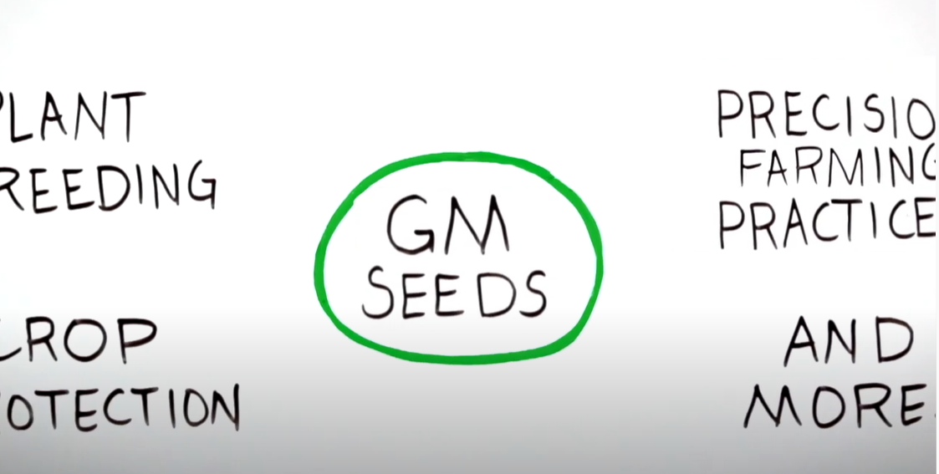
Give it a Minute: GMOs
YouTube Video: https://www.youtube.com/watch?v=frH8a0BYWgs&list=PLaEu0JGyJrzEENDM6qwYBsGCvv6PzkTSy&index=5
Notes:
There is a lot of misinformation out there about GMOs. Here is a short (1min) video to show what GMOs are, and what they are not.
(Picture linked to video)

Slide 7
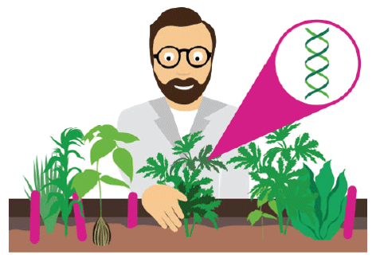
The GMO Process
Step 1: Trait Identification
Fun fact:
For every one trait that is brought to market, more than 6,000 others are screened and tested.
: TRAIT IDENTIFICATION
Scientists conduct research to identify the specific genes responsible for beneficial traits that make crops resistant to disease, pests or drought.
Source: GMOAnswers.com https://gmoanswers.com/sites/default/files/GMOA%2011x17%20Handout_0.pdf
Notes:
The GM process starts by identifying a beneficial trait. This may be a trait that is responsible for disease resistance, pest resistance, or drought protection.

Slide 8
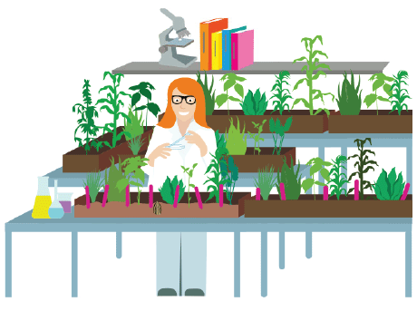
The GMO Process
Step 2: Transformation
Fun fact:
There are many ways to transform a cell. One common method uses agrobacterium - a natural bacterium that passes genes to plants.
: TRANSFORMATION
Once the desired gene has been identified, scientists transfer the gene into a plant seed. The result is a genetically modified organism or GMO. Researchers can also turn off or move a gene within a plant to create a GMO.
Source: GMOAnswers.com https://gmoanswers.com/sites/default/files/GMOA%2011x17%20Handout_0.pdf
Notes:
Once the desired gene has been identified, it is moved into the plant. Today that is done with agrobacterium, a natural bacterium that can pass genes to plants. By putting the desired gene into agrobacterium, the plant absorbs the new gene into its DNA and becomes part of the plant. After this occurs the plant can be bred going forward into different lines of germ plasm.

Slide 9
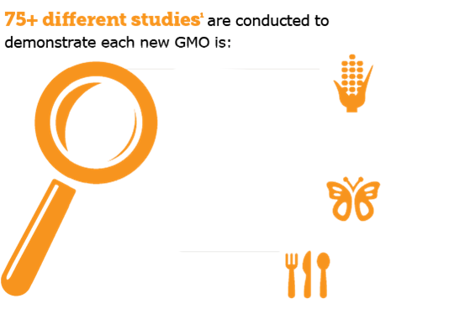
The GMO Process
Step 3: Regulatory Science
Although the regulatory review process begins here, it will continue throughout the GMO process and carry on through the life cycle of the product.
Safe to grow
Crop exhibits expected characteristics (e.g. insect resistance)
Fun fact:
A new biotech seed product takes an average of 13 years and $136 million in R&D before coming to market.²
Safe for the environment and
beneficial insects
: REGULATORY SCIENCE
Safe to eat
Same nutrients as non-GM crops & No new dietary allergens
More than 75 different studies are performed on each new biotech product before commercialization to ensure that they are safe for people, animals and the environment.¹
Sources: Phillips McDougall 2011; GMOAnswers.com https://gmoanswers.com/sites/default/files/2018-11/How%20Does%20a%20GMo%20Get%20to%20Market_0.JPG
Notes:
There is a thorough testing process. Over 75 different studies are conducted to check safety for growing, safety for the environment and for non-targeted (beneficial) insects and safety for people and animals to eat.

Slide 10
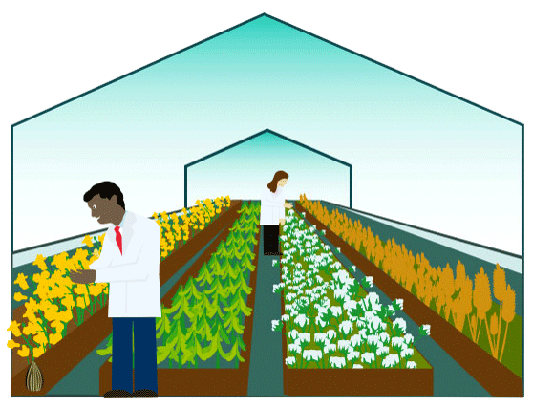
The GMO Process
Step 4: Greenhouse Testing
Fun fact:
Only after several years of rigorous testing are the top performing plants and traits selected to advance to field testing and further regulatory review.
: GREENHOUSE TESTING
After a GMO is developed in the lab, the seedlings are moved to greenhouses where further tests are performed.
Source: GMOAnswers.com https://gmoanswers.com/sites/default/files/GMOA%2011x17%20Handout_0.pdf
Notes:
Seedlings are moved into greenhouses where they are tested rigorously before advancing to field testing, and regulatory studies are continued.

Slide 11
The GMO Process
Step 5: Field Testing
Fun fact:
More than 90 government bodies in more than 60 countries globally review and approve GMOs. In many countries, multiple agencies are involved in the regulation of GMOs.
: FIELD TESTING
Field trials are an important part of developing new products. They provide critical scientific and performance data.
Source: GMOAnswers.com https://gmoanswers.com/sites/default/files/GMOA%2011x17%20Handout_0.pdf
Notes:
Out in the fields, GMOs are tested in real world situations under a variety of conditions. GMOs are tested in areas of the world where they will be brought to market.
More than 90 government bodies in more than 60 countries globally review and approve GMOs. They are reviewed for cultivation and importation.

Slide 12
The GMO Process
Step 6: Getting Seeds to Farmers
Fun fact:
In 2018, 17 million farmers globally chose to plant GMO seeds for better harvests, improved crop quality and the ability to use sustainable farming practices, such as no-till.
: SEEDS TO FARMERS
Farmers choose seeds that are best for their farms and businesses. Both GM and non-GM seeds are available options for farmers.
Source: ISAAA.org https://www.isaaa.org/resources/publications/briefs/55/executivesummary/default.asp
Notes:
Once they have been approved for market, seeds are bulked up by growing them in fields to create inventory for the different geographies. There are many different types of GMO trait combinations that are paired with many varieties of germplasm to create products that are unique to the challenges each field faces.

Slide 13
Genetic Traits Expressed in GMOs in the U.S.
Source: GMOAnswers.com :https://gmoanswers.com/sites/default/files/GMOA-GeneticTraits10crops-4x6_Postcard-Jan2018.pdf
Notes:
There is a lot of misunderstanding of what crops are GMO and what GMO traits are in them. Here is a chart that outlines what is on the market today. As you can see it varies by crop and the challenges faced. GMOs are not a fit for every challenge; therefore, it is used strategically in places where breeding or other technologies would not be the best tool to create a solution.

Slide 14
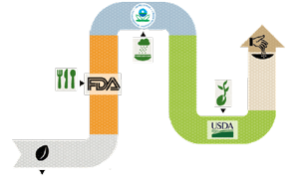
How a GM Seed Gets to Market
No other type of new seed that comes to the market from other breeding methods goes through pre-market regulatory approval, including the thousands of conventional and organic seeds developed from mutagenesis*. Only GMOs are required to be reviewed. Even before the new seed goes through the review process, years of testing and research take place.
*Deliberately engineered DNA mutations
After 13 YEARS and $136 MILLION (on average), the seed variety is brought to market
Review of all GMOs to prove they are safe to grow
Review of GMOs that enhance
pest control
to prove
they are safe for the environment
Review to prove GMOs are safe to eat
New GMO seed variety
www.FoodDialogues.com
Source: Phillips McDougall 2011
Notes:
To get a GMO seed to market they must go through the regulatory process. Once you have the trait you want to approve it goes to the FDA who will deem if they are safe to eat. Then the EPA who will determine if it is safe for the environment and last the USDA to determine if they are safe to grow. No other food is tested and reviewed in this way. It is the most widely tested thing in our food supply. This process takes an average of 13 years and $136 million dollars.
– the US regulatory system currently has the authority and responsibility to assure that all crops and crop products, regardless of the processes used to select, breed or develop them, do not have adverse impacts on consumers or the environment.
It is important to note that regulators around the world currently have the authority and responsibility to assure that foods in the food supply (and the crops used for food) do not have adverse impacts on consumers. So in essence, all plants used as food, regardless of the methods used to select and breed them, are subject to regulation. Since the advent of genetic engineering (used to develop GMO crops), regulators in many countries have required crops developed using these tools to go through a “pre-market” regulatory review prior to being used widely in the production of food or feed. Given the long history of safety associated with new varieties and hybrids developed using conventional breeding and selection, regulators have generally not required that they go through a pre-market review. Conventional breeding practices encompass the use of either induced (using chemicals or radiation) and spontaneous (e.g. field selected) random mutations as a source for new beneficial traits. A “field-selected mutant variant”, while technically having a unique “genetic modification” that may impart a beneficial characteristic, is generally not considered to be a GMO.”

Slide 15
Genetically Modified Crops (GMOs)
Produce Food that is Safe and Nutritious
6.7 billion acres of farmland used for GMO crops since 1996
35+ years that GMO crops have been researched and developed
71 countries where GM crops have been found safe for growing or import
Sources: ISAAA.org https://www.isaaa.org/resources/publications/briefs/55/executivesummary/default.asp; Phillips McDougall 2011; biofortified.org
Notes:
We know from history, and we know from exhaustive research and testing. Food from GM crops has a thoroughly tested, spotless record for safety.
As consumers ourselves, Bayer employees are committed to developing products that contribute to safe and nutritious food choices for all consumers — including our own families and friends. We place the highest priority on the safety of our products, conducting comprehensive product testing and implementing quality control and stewardship programs to support this commitment to safety. We are proud to provide products that contribute to high-quality crops and, ultimately, a safe, healthful and reliable food supply.
And our commitment is backed by a wealth of research and more than 35+ years of experience. With almost 5 billion acres of farmland used for GMO crops since 1996 … and with more than 30 years of research and 20 years of commercial GMO crops … and with more than 1,000 peer-reviewed studies on GMO safety … here’s the conclusion: There has not been a single food safety issue associated with GMOs.
Additional notes: GMO crops were introduced in 1996. Since that time, not a single documented safety issue has been associated with this technology.
Every GM crop is thoroughly tested and those data are reviewed, scrutinized and approved by hundreds of regulatory scientists globally.
More than 1000 peer-reviewed research studies support that GMO crops are just as safe as conventionally bred crops.
Expert Scientific Findings Experts from around the globe are all on the record affirming the safety of GMOs. --FDA, USDA, American Medical Association, the World Health Organization, the U.S. National Academy of Sciences and the European Commission’s Chief Scientific Advisor

Slide 16
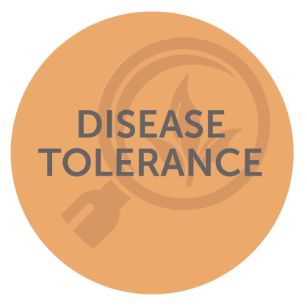
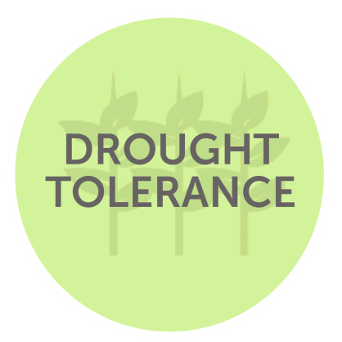
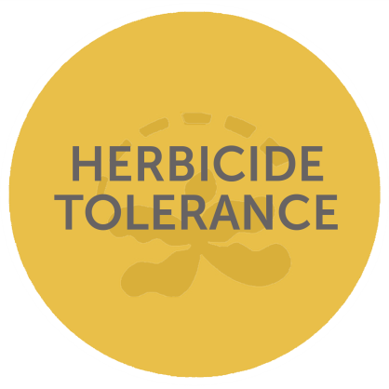
The Benefits of GMOs
Some Examples of the Benefits of GMOs
CORN that is tolerant to drought, insects and disease
SOY that can be planted without tilling, preserving precious topsoil
COTTON that is protected from harmful insects
PAPAYA that resists a disease that threatened to wipe out the crop
Source: ISAAA.org https://www.isaaa.org/resources/publications/briefs/55/executivesummary/default.asp
Notes:
Biotechnology has helped develop highly effective solutions for farmers over the past 30 years, strengthening plants’ resistance to disease, insects and adverse weather conditions. Here’s how the GMO process works: we take a beneficial trait that helps a living thing thrive in nature, like an ability to use water efficiently, and adapt that trait to a new plant so that it can better survive in its environment.
These traits help farmers grow their crops in a sustainable way. For example, farmers are planting corn today that is more tolerant to drought, insects and disease. GMO soybeans and corn enable farming without tilling, which helps preserve precious topsoil and reduce CO2 emissions.
Another example of the benefits of biotechnology is papaya, which faced extinction from disease until resistance to a papaya virus was developed through biotechnology.
Bayer and others in the industry are currently working on a new generation of GMO crops that could deliver important health benefits, like a soybean that can be converted to cooking oil without harmful trans fat, or rice that provides vitamin A, an important nutrient that is often lacking in diets in developing countries today.
For use if the topic of GMO safety is raised:
Bayer’s committed to helping people find information about GMO safety, making it available for anyone to determine for themselves that GMOs are safe.
Bayer is also part of a group of industry researchers, scientists and academics engaging with consumers about what GMOs are and why some farmers use them. One key way we’re working with others to engage consumers is through GMOAnswers.com, a website where anyone can submit their questions about GMOs and have them answered by independent scientists and industry experts.
Third parties like the American Medical Association and the World Health Organization have reviewed the data on GMOs and are in agreement as to their safety. This is on top of positive FDA, USDA and EPA safety determinations.

Slide 17
Better Harvests
Between 1996 and 2018, Crop Biotechnology was Responsible for an Additional:
32.6
Million Tonnes of Cotton Lint
278
Million Tonnes of Soybeans
498
Million Tonnes of Corn
Notes:
Biotechnology has enabled us to dramatically increase production of food and fiber since their introduction in 1996. We’re realizing production of hundreds of metric tons beyond what would be possible with conventional crops. This increase of production helps to reduce the cost of clothing and make a balanced meal more accessible.
It’s important to note that these gains are being realized by farmers small and large.

Slide 18
Economic Benefits
Economic gains of ~U.S. $225B were generated globally by biotech crops between 1996 to 2018.
30% Due to reduced production costs
70% Due to substantial yield gains
In 2018, farmers in developing countries received $4.41 as extra income for each extra dollar invested in GM crop seeds
Notes:
The economic benefits of GMOs are powerful, with almost $225 billion generated by increased production and efficiency enabled by GMO innovations.
It’s important again to note that GMOs benefit all farmers. The vast majority of farmers who plant GMO seeds are small farmers in the developing world, and they are seeing important benefits in production and efficiency. It’s a common misperception that GMOs and “big agriculture” go hand in hand. In fact, GMOs are equal-opportunity advances. Farmers of all sizes are realizing these benefits.
It’s important to note that these gains are being realized by farmers small and large.

Slide 19
Environmental Benefits
The reduction in pesticides from 1996 to 2018 was estimated at 776 million kilograms or 8.6% reduction
In 2018 alone, biotech helped prevent an estimated 23 billion kg of CO₂ emissions, equivalent to removing 15.3 million cars from the road for a year.
Without biotech, it would take an additional 60 million acres to produce the same amount of food produced in 2018.
Notes:
The environmental benefits of biotechnology are notable. Through biotech traits, we’ve seen substantial reduction in use of pesticides.
The reduction in pesticides from 1996 to 2018 was estimated at 776 million kilograms or 8.6% reduction.
This is equal to more than 1.6 times China’s total crop protection product use each year. As a result, farmers who grow GM crops have reduced the environmental impact associated with their crop protection practices by 19 percent
We’ve seen reduced CO₂ emissions from farm operations, In 2018 alone, biotech helped prevent an estimated 23 billion kg of CO₂ emissions, equivalent to removing 15.3 million cars from the road for a year. And we’ve been able to produce more food from less land, preserving more of our natural habitat around the world.
Without biotech, it would take an additional 60 million acres to produce the same amount of food produced in 2018.
This is equivalent to needing an additional 14 percent of the arable land in the United States, or roughly 38 percent of the arable land in Brazil or 16 percent of the cropping area in China.

Slide 20
GMO Safety

Slide 21
GM Crop Safety
GM crops are reviewed by hundreds of independent risk assessors and scientists.
Every credible U.S. and international food safety authority that has studied GM crops has found that they are safe & no health effects attributable to their use.
Since 1992, 71 different countries have granted more than 4,485 commercial use approvals for 403 different biotech events in 29 biotech crops.
In many countries there are multiple regulatory authorities (up to seven in one country) with the responsibility of assessing a particular aspect of safety.
Source: ISAAA.org https://www.isaaa.org/resources/publications/briefs/55/executivesummary/default.asp
Notes:
GMO crops are reviewed by hundreds of independent risk assessors and scientists. Every credible U.S. and international safety authority has deemed they are as safe as other traditional crops.

Slide 22
In the U.S., Three Regulatory Agencies have Oversight for GM Crops
Is it safe for the environment?
Is it safe for humans and animals to eat?
Nutritional changes
Compositional changes
Is it safe for humans and the environment?
Globally, >90 additional government bodies also review each product before it can be commercialized.
Notes:
There are a number of agencies around the world and in the United States responsible for ensuring food safety.
It is important to Bayer that there is a strong regulatory framework in place to ensure the safety of our seeds developed using biotechnology – BEFORE they can available to farmers for planting. There is broad global agreement among food scientists, toxicology experts and regulatory food safety officials on how to evaluate the safety of GM foods. Bayer follows these expert recommendations.
Biotech crops are reviewed and tested more than any other crops in the history of agriculture. In addition, each of Bayer’s products has undergone many years of research, field trials and comprehensive testing before it is submitted for regulatory review.
In the United States, the U.S. Food & Drug Administration, Department of Agriculture and Environmental Protection Agency share the responsibility for reviewing the safety of genetically modified (GM) plants based on their legal authority and scientific expertise.
Specifically, the FDA is responsible for the safety and appropriate labeling of food and feed products grown from GM crops; this includes a review of nutrition composition and potential presence of allergens.
USDA is responsible for ensuring that GM crops are safe for agriculture and the environment, overall, before they are available in the marketplace. USDA oversees and regulates field testing, movement and incorporation of biotechnology crops and seeds.
The EPA is responsible for the safety of pesticides, including GM plants that produce traits to protect the plants from insect pests and disease. The EPA oversees field testing, as well as the sale and distribution of pest-protected crops to ensure public and environmental health.

Slide 23
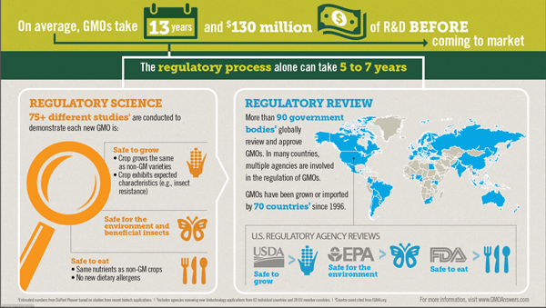
GMO Research, Review and Regulation
Source: GMOAnswers.com https://gmoanswers.com/sites/default/files/2018-11/How%20Does%20a%20GMo%20Get%20to%20Market_0.JPG
Notes:
Over 75 different studies are conducted to check safety for growing, safe for the environment and non-targeted or beneficial insects and safe to eat by people and animals. More than 90 government bodies in more than 60 countries globally review and approve GMOs. In the U.S. GMOs are regulated by the USDA, EPA and FDA.

Slide 24
Expert Scientific Findings
U.S. Food and Drug Administration
“Food and food ingredients derived from GE plants must adhere to the same safety requirements … that apply to food and food ingredients derived from traditionally bred plants. The consultation is complete only when FDA’s team of scientists are satisfied with the [GE Food] developer's safety assessment and have no further questions regarding safety or other regulatory issues.”
National Academy of Sciences
The study committee found “no substantiated evidence of a difference in risks to human health between currently commercially genetically engineered (GE) crops and conventionally bred crops, nor did it find conclusive cause-and-effect evidence of environmental problems from the GE crops.”
American Medical Association Council on Science and Public Health
“Bioengineered foods have been consumed for close to 20 years, and during that time, no overt consequences on human health have been reported and/or substantiated in the peer-reviewed literature.”
May 2013
May 2016
June 2012
Notes:
These are just a few examples of the independent research findings on GMO safety, from notable organizations in government and the private sector.
Food and Drug Administration
World Health Organization
American Medical Association Council on Science and Public Health

Slide 25
Expert Scientific Findings
American Council on Science and Health
“It’s irresponsible to assert that GMOs pose any dangers to consumers or the environment since billions of tons of crops have been produced using GMO technology and harvested over many years, and still not a single case of adverse health or environmental effects from such farming practices have been documented.”
Anne Glover Former European Commission Chief Scientific Advisor
“If we look at evidence from 15 years of growing and consuming GMO foods globally, then there is no substantiated case of any adverse impact on human health, animal health or environmental health, so that’s pretty robust evidence, and I would be confident in saying that there is no more risk in eating GMO food than eating conventionally farmed food.”
February 2013
July 2012
Notes:
American Council on Science and Health
Anne Glover, European Commission Chief Scientific Advisor

Slide 26
Expert Scientific Findings
European Academies Science Advisory Council
“The production of more food, more sustainably, requires the development of crops that can make better use of limited resources …. Sustainable agricultural production and food security must harness the potential of biotechnology in all its facets.”
American Association for the Advancement of Science
"The science is quite clear: Crop improvement by the modern molecular techniques of biotechnology is safe."
And Bill Gates
Business Leader,
Entrepreneur,
Philanthropist
"The world faces a choice, by spending a relatively little amount of money on proven solutions, we can help poor farmers feed themselves and their families and continue writing the story of a steadily more equitable world. Or we can decide to tolerate a very different world in which one in seven people needlessly lives on the edge of starvation."
June 2013
October 2012
January 2012
Notes:
European Academies Science Advisory Council
American Association for the Advancement of Science
Bill Gates – Business Leader, Entrepreneur, Philanthropist
Genetically modified (GM) technology incorporates desirable traits into crops, resulting in plants that can be better able to resist insect and disease pressure while continuing to be nutritionally equivalent to non-GMO plants. GMOs also provide environmental benefits through, among other things efficient land use.

Slide 27
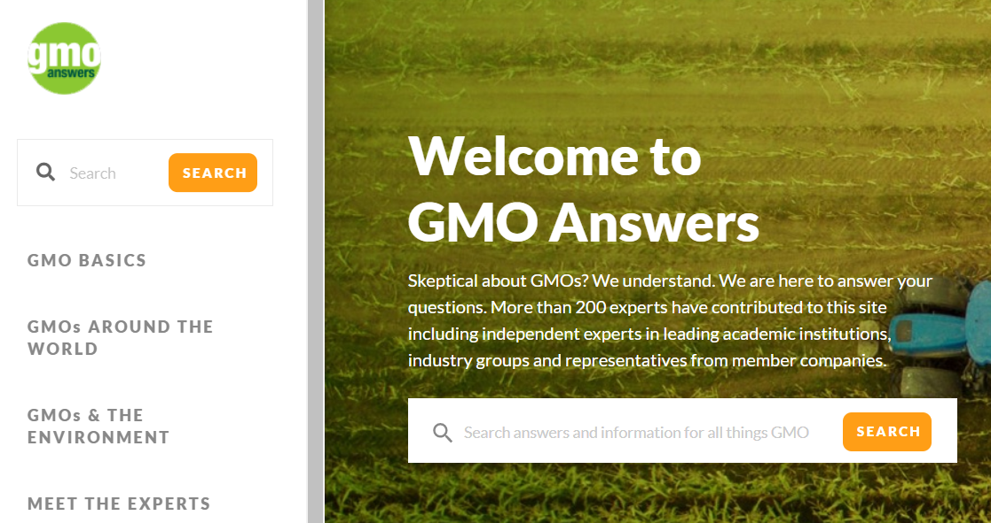
More Information Is Available at
GMOAnswers.com
Notes:
With the volume of evidence that we’ve seen regarding GMO safety and benefits, it’s fair to ask how we ended up with so many questions and concerns over the past few years.
There are a variety of reasons for that. One of them is that Bayer and others who are focused on innovation in agriculture didn’t do as good of a job as they needed to in explaining what they were doing. They’re working hard to fix that, to provide more information and answer questions from consumers. This talk helps add clarity for consumers.
I encourage you to visit GMO Answers, an industry resource that provides more detailed information on GMO benefits and safety. Questions are answered by experts from around the world, including Bayer and non-Bayer employees.
You can allow follow Bayer on a variety of social media platforms. Feel free to join this important discussion!

Slide 28
GMOs have played an important role in agriculture for 25 years and continues to be a safe and precise tool that is improving the way food is grown.

Slide 29
Thank you for communicating modern agriculture.
Customize this presentation for your audience. Insert your brand logo, contact information, re-arrange slides, and so forth. Please contact ScientificResources@bayer.com with questions or further context about the slide content.
Looking for ag resources? Bayer Crop Science Resource Library.

