Slide 1
Plant Breeding Basics

Slide 2
Presenter Notes
Thank you for communicating modern agriculture.
Customize this presentation for your audience. Insert your brand logo, contact information, re-arrange slides, and so forth. Please contact ScientificResources@bayer.com with questions or further context about the slide content.
Looking for ag resources? Bayer Crop Science Resource Library.

Slide 3
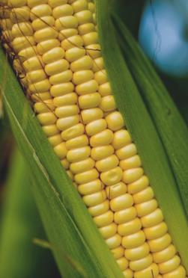
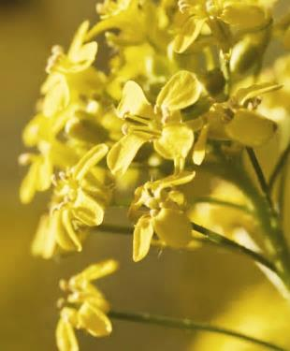
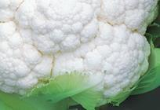
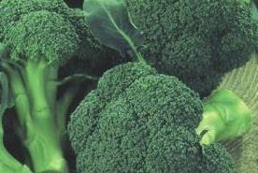
Many of the Foods Today Are a Result of Breeding Innovation
Teosinte To Today’s Corn
Mustard Plant To Today’s Cauliflower And Broccoli
Notes:
Breeding has been ongoing since the dawn of agriculture. As our understanding of the genome has evolved, researchers improved efficiency and accuracy in breeding.
Most plant species have benefited greatly from agricultural breeding, and a good number of the fruits, vegetables and grains we enjoy today did not exist in their current state prior to selective breeding.
For hundreds of years, plant breeding was a relatively straightforward process. For example, a corn or maize farmer would choose the biggest, healthiest ears and replant some of those seeds the following season. Largely through this trial and error, farmers were able to breed plants with a variety of desirable traits. Increased production … resistance to disease … even improved flavor, texture or freshness. Today breeders select for those traits making the process more efficient.
Biotechnology and its products, commonly referred to as GMOs, get a lot of attention these days, but the ability to breed plants has also greatly improved along with our increased understanding of the genome over the past 30 years. Today, rather than depending mostly on educated guesses and trial and error, we increasingly understand the genetic traits that will deliver a desirable impact, and can select those traits much more quickly and effectively.

Slide 4
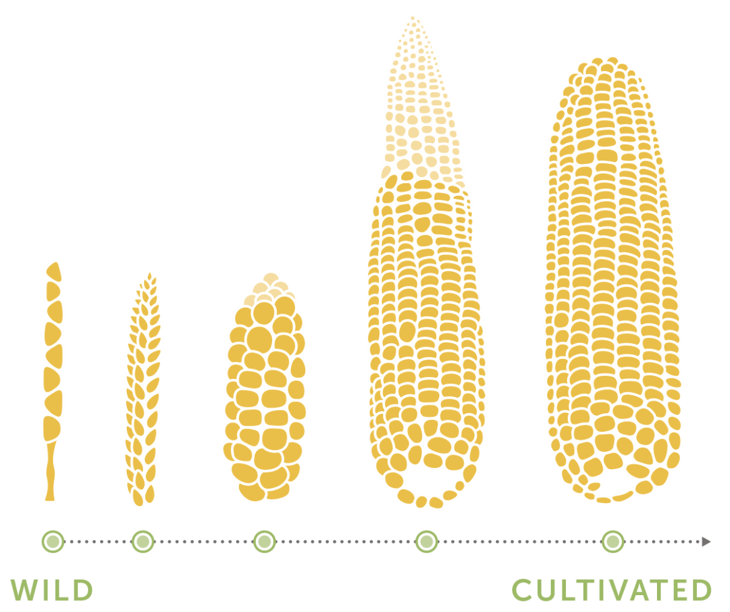
Crop Domestication Is Genetic Modification
In the late 20th century, advances in technology enabled the expansion of diversity of crops. For years, university, government and company scientists intensively researched and refined this process. A major result has been GM seeds that maintain or increase the yield of crops while requiring less land and fewer inputs, both of which lessen the impact of agriculture on the environment and reduce costs for farmers.
Notes:
You can see here the evolution of teosinte (pictured far left) to modern corn (pictured far right). Through breeding and later biotech people now have an ear that yields significantly more and creating a much more edible crop. The introduction of GM seeds reduced risk for farmers who are challenged with weeds, insects and drought. These improvements reduce the impacts on the environment and reduces costs for farmers.

Slide 5
Modern Breeding Brings the Best from Plants Together More Efficiently
Breeding can improve plant health or provide consumer benefits. Here are a few ways breeding improves crops:
Disease Resistance
Insect Resistance
Water Utilization
Plant Health
Improved Harvest
Shelf Life
Color
Flavor
Size
Notes:
Breeding has been happening for over 10,000 years. In its early stages breeders would take one plant with a desirable trait – let’s say sweet fruit - and another plant that let’s say bears 20% more fruit – and would cross pollinate them hoping to get a plant with sweet fruit that delivers more fruit. This is still done today, but with modern breeding methods they can see the genetics that deliver improved quality – making the process more efficient. It is the difference of looking for a needle in a haystack or a needle in a pin cushion.
Researchers can breed for traits that help farmers – disease control, insect tolerance, plant health and yield. They can also breed for qualities that benefit consumers and retailers such as shelf-life, taste, color, and size.

Slide 6
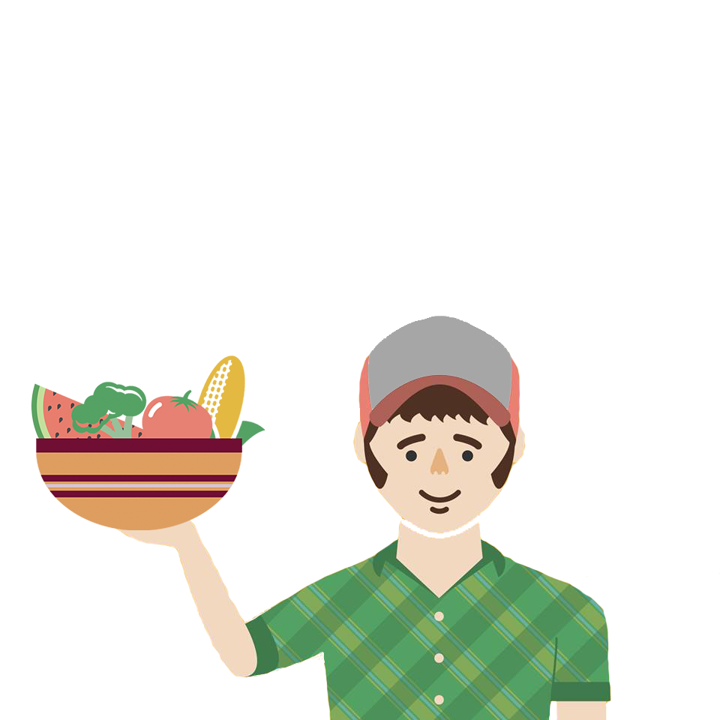
What Goes into a Great Vegetable
Vegetables are among the most nutritious foods available, but taste, texture and convenience are keys to increasing consumption.
Sensory Experience
Convenience
Nutrition & Health
Source: Mon Veg Consumer Research (2008) US & EU-5 Consumer Preference for Fresh Vegetables
Notes:
From seed to sauté pan, researchers are committed to helping farmers grow fresh fruits and vegetables — but growing them is only half the battle.
According to the U.S. Department of Agriculture, our plates should be filled halfway with fruits and vegetables at any meal, for an average of five to nine servings a day. Yet, Americans are currently eating only 1/8 of a plate of fruits and vegetables per meal. This is also a trend worldwide, with most people falling far below that recommended daily consumption.
Ideal flavor is the start for a solution to eating more vegetables, but it’s more complicated than that. If the vegetable doesn’t look, feel or smell right, you’re probably not even going to take that first bite. If it doesn’t stay fresh long enough for you to finish it, you probably won’t buy it. And the more slicing, dicing, peeling or packaging that you have to deal with, the more barriers between you and that nutritious food.
Bayer has a dedicated sensory scientist whose primary role is to study consumers’ perceptions and provide findings to breeders, who use the information to grow produce that will be appealing to consumers.
Convenience is also really important to consumers. We look at size, shape and other attributes to make all of us want to eat our vegetables.
In addition to taking these important factors into consideration, Bayer also has to make sure every seed will grow successfully in farmers’ fields. We do a lot of testing in the field across the country to know if these seeds will grow well in different conditions. Having this knowledge helps farmers produce more and reduces waste.
Ultimately, we’re able to combine these important factors to develop seeds that are more flavorful and pleasing to consumers, and that can be a big help in boosting consumption of these nutritious foods. Let’s look at a few examples of current and developing projects.

Slide 7
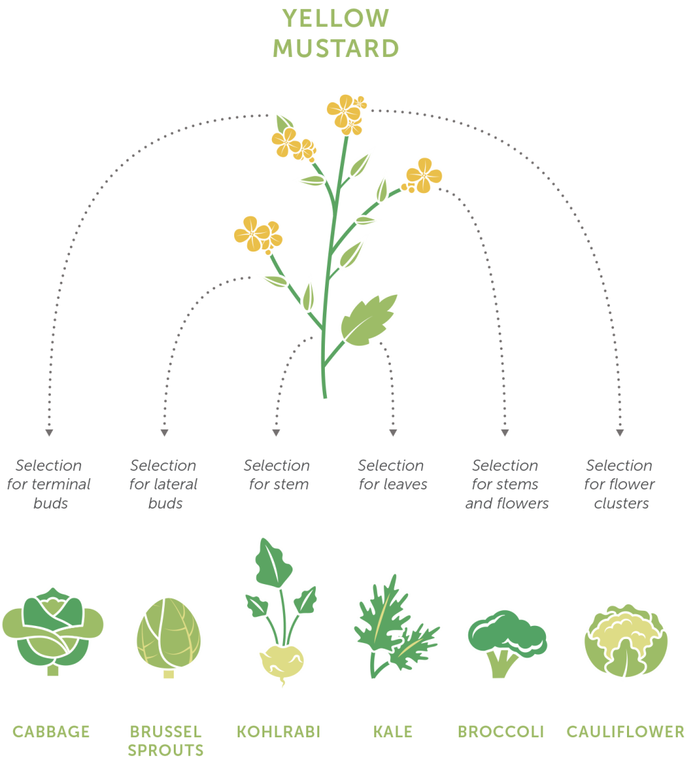
The Evolution of Crop Improvement Building on Genetic Diversity
Farmers have intentionally changed the genetic makeup of all the crops they have grown and the livestock they have raised since domestic agriculture began 10,000 years ago. Almost every fruit, vegetable and grain that is commercially available today has been altered by human hands, including organic and heirloom seeds.
Notes:
In the late 20th century, advances in technology enabled us to expand diversity of crops. For years, university, government and company scientists intensively researched and refined this process. A major result has been GM seeds that maintain or increase the yield of crops while requiring less land and fewer inputs, both of which lessen the impact of agriculture on the environment and reduce costs for farmers.

Slide 8
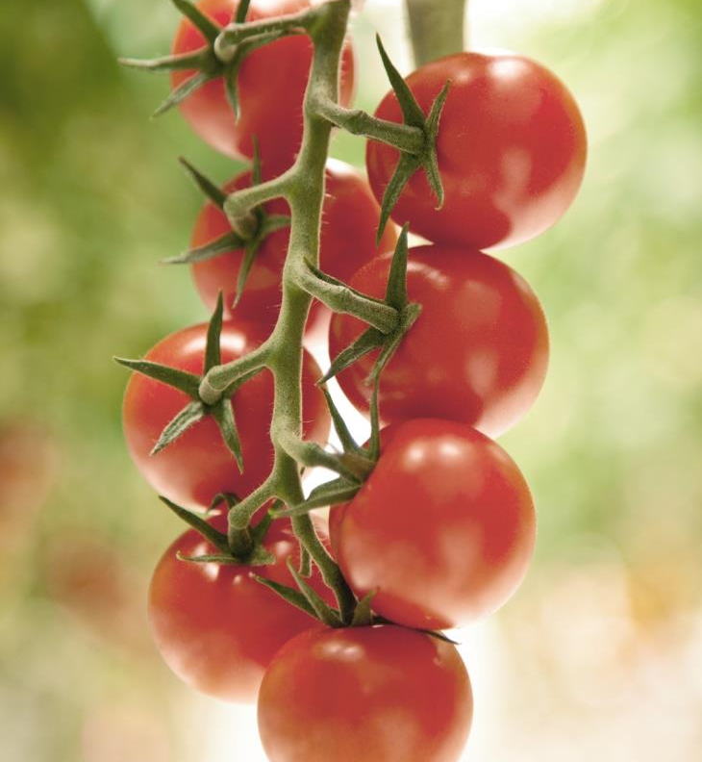
Improved Flavor and Color Builds
Consumer Appeal
Wild tomato traits bred into commercial varieties for sweeter taste
Notes:
When it comes to flavor and color, tomatoes are a great example of what we’re focused on today. We know from our sensory lab research that many consumers are dissatisfied with some of today’s tomatoes and prefer them with a sweeter flavor. Our breeders found a great source for sweetness in wild tomatoes and were able to breed these taste traits into a commercial variety, boosting the sweetness factor.

Slide 9
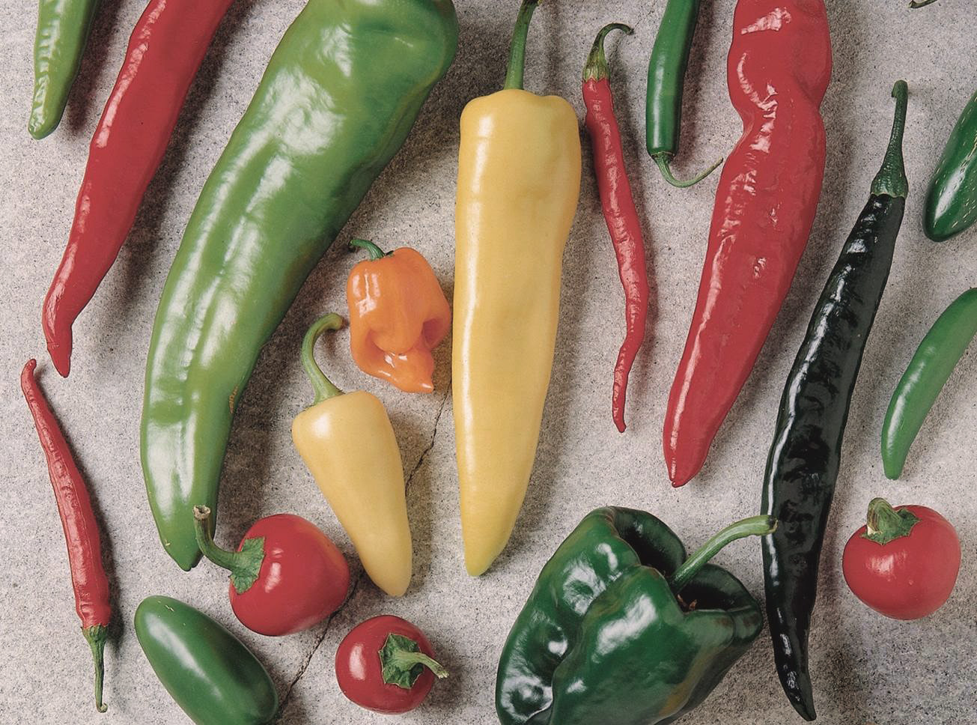
Phytopthora Resistant Peppers Are Improving Crop Production
Advanced breeding gives pepper varieties resistance to one of the most destructive diseases
Notes:
Our vegetable seed breeders are working on Phytopthora-resistant peppers. Phytophthora blight is a widespread and devastating disease, which can wipe out entire pepper fields, causing enormous losses.
Pepper growers currently utilize a combination of fungicide applications and cultural practices such as crop rotation and water management to protect against this disease. Bayer estimates anywhere from 10 – 50% of the total fungicide expenditures in United States pepper production are made for management of Phtyophthora. Pepper growers in commonly impacted areas make multiple fungicide applications annually specifically for Phytophthora.
Elite commercial pepper hybrids with high resistance to Phytophthora blight will enable farmers to increase productivity, simplify management and potentially reduce fungicide applications.

Slide 10
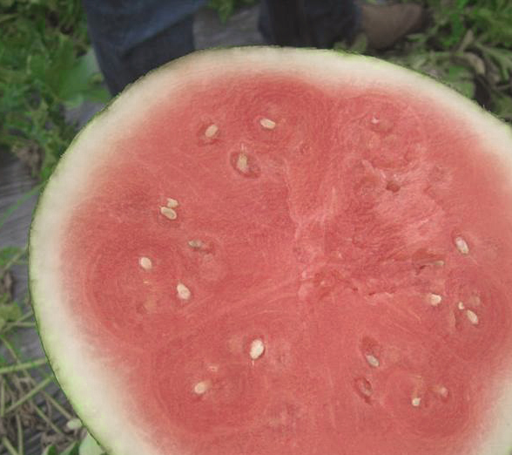
Extended Quality Watermelon
This watermelon loses much less juice, so is less messy when slicing, eating and storing after it is cut.
Ideal for fresh-cut halves, quarters, slices and cubes.
Notes:
In watermelon, our breeding efforts are leading toward a melon that loses much less juice when it is cut. This is a boost to both sensory experience and convenience. Watermelons are always a great nutritious treat, but they’re not very convenient. They’re too big to fit in your lunchbox when they’re whole, and they’re messy once they’re cut … and all that mess can lead to consumers skipping out on a highly nutritious treat.
This new variety we’ve developed is ideal for cutting into cubes or slices without a mess. And if it’s easier to take with you, it’s much more likely to end up as part of your lunch.

Slide 11
Sweet Tasting, More Convenient Mini Bell Peppers
Better Value One third the size of standard bell peppers, at an equally affordable price point
Sweet Tasting & Crunchy BellaFina® peppers are small in stature but their sweet flavor and crunchy texture are every bit as appealing as traditional colored bell peppers
Nutritious Excellent source of vitamin C
Notes:
Our BellaFina bell peppers include improvements in flavor, convenience and shelf life. They’re small, about 1/3 the size of a traditional bell pepper, which means that they provide a more convenient serving size for many consumers, with less chance for waste. They’re also sweeter and crunchier than most pepper varieties, which matches what consumers have told us that they’re looking for in our sensory research. And, like all peppers, BellaFinas are a great source of vitamin C.
It’s also important to call out the color of the peppers. Years ago, most consumers likely purchased the green peppers as they were less expensive than the yellow, orange and red. But the color variety does more than just make your dish look better. Each color gives the pepper a slightly different variance of nutritional values. For example, a red pepper has significantly more vitamin C than a green pepper. (https://ndb.nal.usda.gov/ndb/nutrients/report?nutrient1=401&nutrient2=&nutrient3=&fg=11&max=25&subset=0&offset=0&sort=c&totCount=777&measureby=m)

Slide 12
Building Better Salads and Wraps with Frescada® Lettuce
A Sweet Tasting Lettuce Very low in bitterness and crunchier than traditional Romaine
Greener Color and More Flavor Compared to iceberg
Nutritious 246% of the folate and 174% of the Vitamin C in ordinary iceberg lettuce
Notes:
Bayer’s plant breeders combined the best attributes of iceberg and romaine lettuce to develop Frescada lettuce. Frescada lettuce has the sweet taste and crispy texture of iceberg, but is greener in color and has more flavor. It also delivers more vitamin C and folate than iceberg lettuce. It’s a perfect start for a lettuce wrap or salad.

Slide 13
Breeding Will Continue to be the Foundation in Achieving Healthful and Delicious Meals
Notes:
As you can see there is a lot that can be accomplished with breeding. You will hear about many other types of products and technologies used in agriculture, but breeding continues to be the leading technology to deliver healthy and delicious produce to the market.

Slide 14
Presenter Notes
Thank you for communicating modern agriculture.
Customize this presentation for your audience. Insert your brand logo, contact information, re-arrange slides, and so forth. Please contact ScientificResources@bayer.com with questions or further context about the slide content.
Looking for ag resources? Bayer Crop Science Resource Library.

