Slide 1
Understanding Pesticides

Slide 2
Presenter Notes
Thank you for communicating modern agriculture.
Customize this presentation for your audience. Insert your brand logo, contact information, re-arrange slides, and so forth. Please contact ScientificResources@bayer.com with questions or further context about the slide content.
Looking for ag resources? Bayer Crop Science Resource Library.

Slide 3
Pesticides are an Integral Part of our World
Pesticides…
…keep harmful insects and pests out of homes and businesses
…remove weeds from yards, gardens
…prevent diseases from infecting household plants and gardens
…are found in household cleaning agents
85% of all U.S. households have at least
one pesticide in use at their home.
Source: http://ipm.ncsu.edu/safety/factsheets/pestuse.pdf
Notes:
Pesticides: Pesticides are used to help both home gardeners and farmers protect their plants from insects, weeds and/or fungi. A pesticide is any substance or mixture of substances used to alter the life cycle of any pest. Pesticides can be a naturally derived or synthetically produced substance. They can also be an organism, for example, the bacteria, Bt, which is used to control a number of insect pests. Pesticides are also referred to as crop protection products and include herbicides, insecticides, and fungicides.

Slide 4
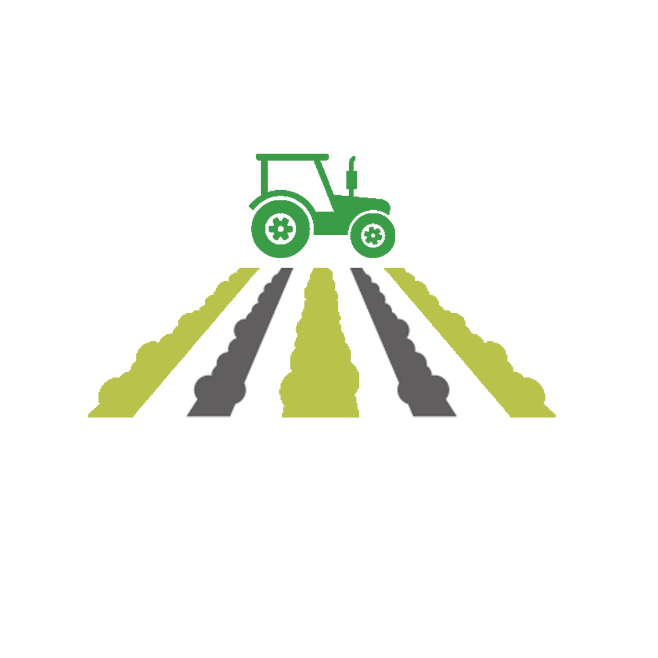
Why Do Farmers Need Crop Protection Tools?
Crop protection tools are vital for an abundant and reliable food supply.
Each year, 20-40% of crops are lost even with the use of crop protection products. Without crop protection, these losses could be at least 50% more.
.
Sources: OECD-FAO https://www.oecd-ilibrary.org/agriculture-and-food/oecd-fao-agricultural-outlook-2012_agr_outlook-2012-en; FAO http://www.fao.org/plant-health-2020/about/en/
Notes:
Most farmers, including both organic and conventional farmers, use some type of pesticide to keep bugs, weeds and other pests from hurting their crops. If they didn’t, they wouldn’t be able to harvest nearly as much food – at a time when the world’s population is growing rapidly.

Slide 5
Pesticides Play a Key Role in Crop Protection
Farmers use pesticides along with other tools to protect their crops and preserve their fields
Safely
Precisely
Responsibly
Right Place, Right Time,
Right Instruction, Right Amount
Source: http://ipm.ncsu.edu/safety/factsheets/pestuse.pdf
Notes:
When it comes to protecting crops from pests like insects, plant disease, and weeds, there’s no silver bullet. Fortunately, today’s farmers have multiple options. Pesticides are one tool farmers can use, but they also understand it’s not sound agriculture to use them alone, or in excess.
Further, farmers do not wish to overuse expensive products, so they also use many other methods such as mechanical tillage, proper timing of planting, and frequent crop rotation. And it’s these everyday acts that remain at the core of what farmers do. But even with the most thorough commitment to these practices, pests can persist. That’s why, for many farmers, pesticides are one option that they use precisely and judiciously to help protect their crops.
To ensure that farmers know the best way to apply the right amount of pesticides at the right time for their specific needs, they must periodically complete the pesticide training and certification process for their state.

Slide 6
Types of Pesticides Used in Agriculture
Herbicides – Protect crops against weed competition
Insecticides – Reduce crop losses from insect feedings
Fungicides – Promote healthy plants and keep them free of diseases
Pesticides can be organic or synthetic
Source: http://ipm.ncsu.edu/safety/factsheets/pestuse.pdf
Notes:
Pests in agriculture either eat the crops or use up the nutrients that help them grow. A pesticide is a general term of tools that are used to eliminate pests. The most common ones are:
Herbicides are weed killers. Crops compete with about 30,000 species of weeds.
Insecticides that target problematic insects which include over 10,000 species of plant-eating insects and 3,000 species of nematodes.
And fungicides are aimed at reducing losses from diseases caused by fungi.
There are others as well. But these are the ones most used in agriculture.

Slide 7
Give it a Minute:
How Do Farmers Use Pesticides?
YouTube video: https://www.youtube.com/watch?v=QqRnbFTeIcc&list=PLaEu0JGyJrzEENDM6qwYBsGCvv6PzkTSy&index=2&t=0s&pbjreload=101
Notes:
Pesticides can be difficult to understand, so here is a short (1 min) video to explain what they are and how they are used.
(Picture is hyperlinked to the video)

Slide 8
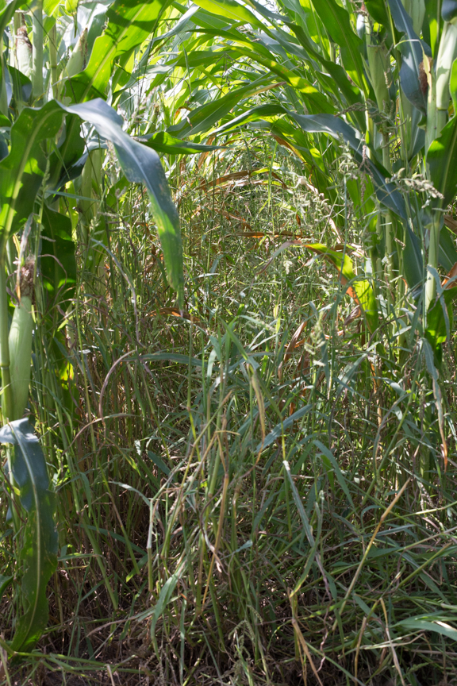
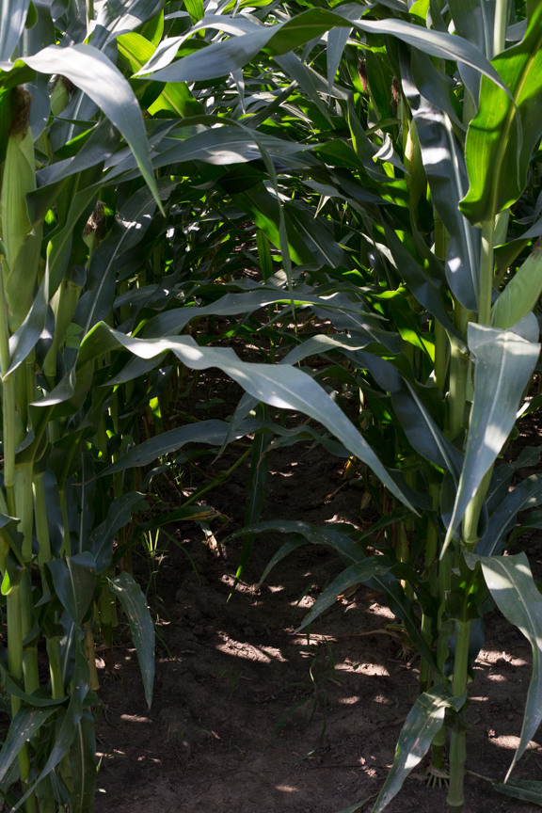
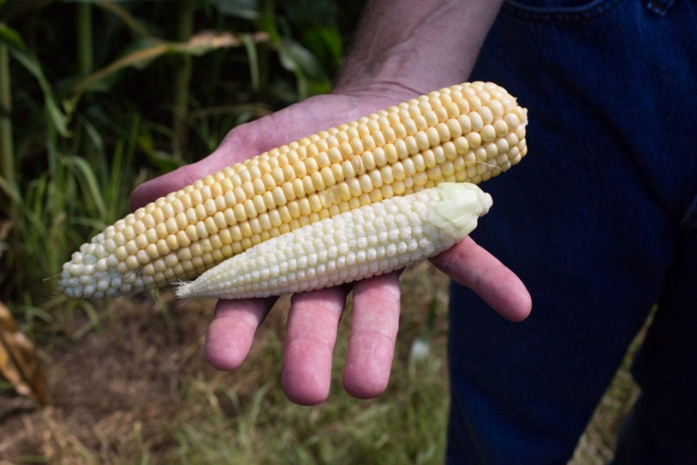
Herbicides Eliminate Weeds That Compete With a Crop for Light, Moisture and Nutrients
Globally, farmers lose 30 to 40 percent of their crops because of pests and diseases. Without crop protection chemistry, these losses could easily double.
Source: FAO http://www.fao.org/docrep/014/i2215e/i2215e.pdf
Notes:
These photos were taken in a Research Farm in West Lafayette, Indiana. The photos on the far left and right are the same seed, planted on the same day. The field on the right was treated with an herbicide and produced the ear on top. The field on the left was not treated for weeds and produced the small ear on the bottom.
This visual helps demonstrate the effects weeds have on crops – by competing for light, moisture and nutrients, crops will be significantly impacted if weeds are not controlled. Herbicides along with other management tools, such as crop rotation, cover crops and turning the soil (tillage) minimize losses from weeds.
Herbicides are used in both organic and conventional farming. Farmers diversify both the methods and herbicides they use. They receive training on the types and amounts of herbicide they should use so they are specific to the weed challenges in their fields.
In 1991, the estimated average annual monetary loss caused by weeds with current control strategies in the 46 crops grown in the United States was $4.1 billion.

Slide 9
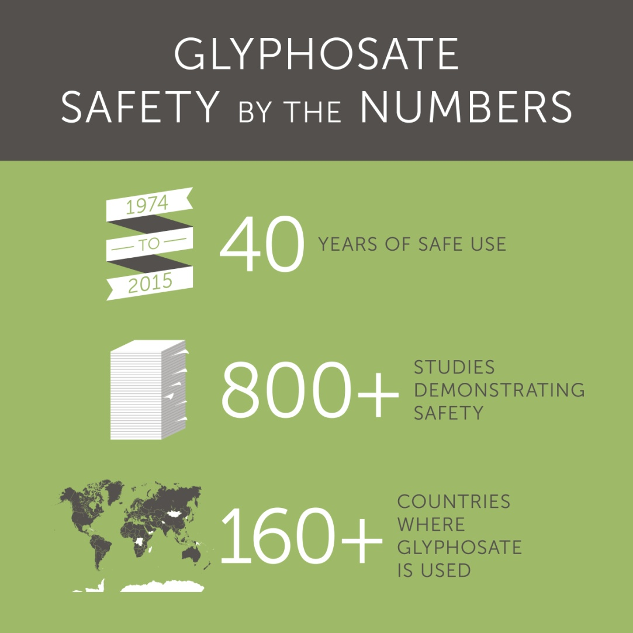
Glyphosate is the Most Thoroughly Evaluated Herbicide in the World
Works by stopping an enzyme that exists in plants – not humans or animals
Approved by regulatory agencies in over 160 countries globally
Is categorized in U.S. EPA’s most favorable category (IV) for acute toxicity
Breaks down in the soil into naturally occurring elements such as carbon dioxide and phosphate
Source: Williams, G.M., Kroes,,R., and Munro,I.C. 2000
Notes:
When you hear about herbicides, glyphosate is usually part of the conversation. Its popularity in both agriculture and in home use is not only due to its effectiveness but also its safety record.
Glyphosate has a long history of safe use. In evaluations spanning four decades, the overwhelming conclusion of experts worldwide has been that glyphosate, when used according to label directions, does not present an unreasonable risk of adverse effects to humans, wildlife or the environment.
In fact, glyphosate safety is supported by one of the most extensive worldwide human health, crop residue and environmental databases ever compiled on a pesticide product.

Slide 10
Give it a Minute: Glyphosate
YouTube video: https://www.youtube.com/watch?v=-GANtq0jBmg&list=PLaEu0JGyJrzEENDM6qwYBsGCvv6PzkTSy&index=2
Notes:
Here is a short (1min) video to share information on glyphosate.
(Picture is hyperlinked to the video)

Slide 11
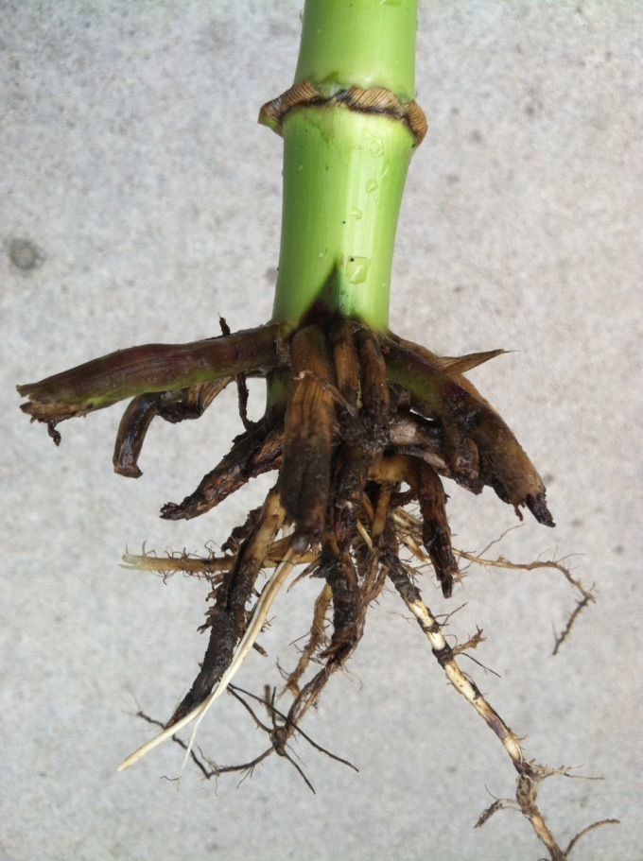
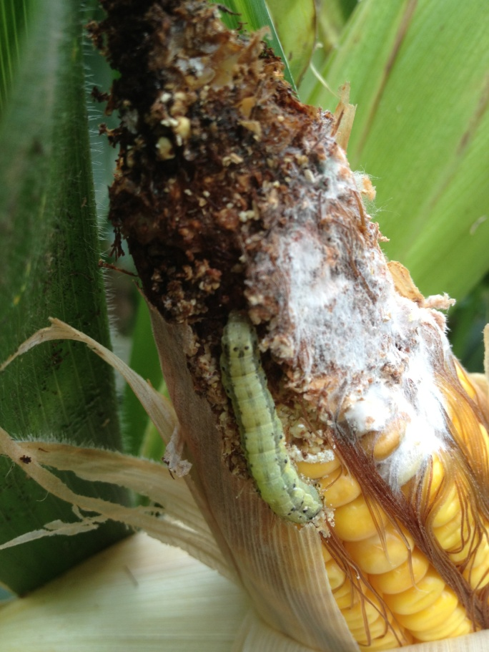
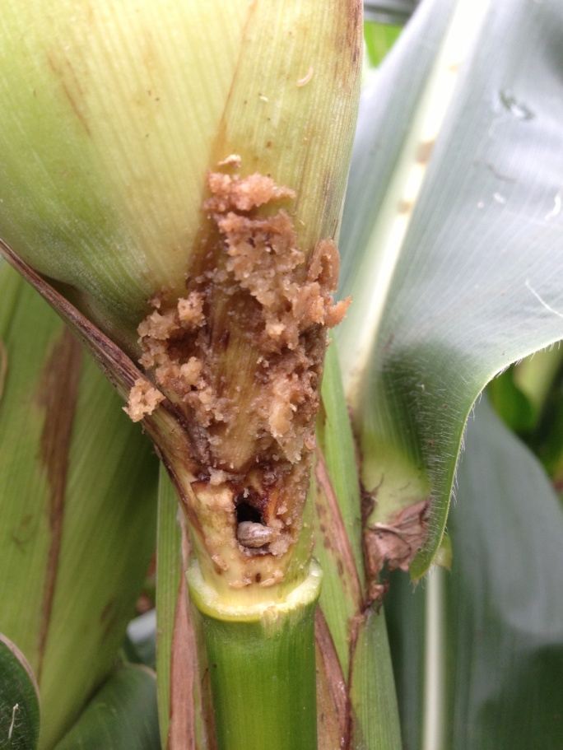
Precision is An Important Part of Insecticide Use
Farmers have many choices to manage insects and may use one or a combination of tools depending on the insect, crop and other factors.
Sprays
GMOs
Seed Treatments
Crop Rotation
And more
Corn Rootworm
Damage
Corn Earworm Damage & Secondary Disease
European Corn Borer Damage
Sources: http://www.bt.ucsd.edu/overview.html; http://www.isaaa.org/kc/cropbiotechupdate/article/default.asp?ID=14459
Notes:
There are approximately 600 insects classified as agricultural pests of the 200 million species of insects on earth. Most insects are beneficial or have no impact on agriculture. Which is why it is so important that agriculture use insecticide methods with precision that only impact problematic insects.
A farmer will decide which method to use based on the insect, crop, level of infestation, timing and unique conditions of the farm. There are many types of insecticides including organic and synthetic chemistries. And there are many ways farmers can target these pests including sprays, GMOs, seed treatments, crop rotation and cover crops to name a few. These are key components to an integrated pest management program.
Pesticides work best when used in the right place, at the right time and in the right amount.
Pest and weed levels change every season, so farmers adapt to use only what’s necessary.
Modern tools like GPS guidance on sprayers and site-specific nozzles help farmers use only as much as needed.
Recent advances have given farmers tools that are targeted at specific problematic pests. One of the most talked about are GMOs that come from a B.t. protein (Bacillus thuringiensis). This is a naturally occurring protein that is found in soil all over the world that has been used in organic farming for over 50 years. The adoption of GMO crops have reduced broad spectrum synthetic pesticides significantly. (varies with crop and location ) http://www.isaaa.org/kc/cropbiotechupdate/article/default.asp?ID=14459).
Corn insecticide use by both GMO seed adopters and non-adopters has decreased—only 9 percent of all U.S. corn farmers used traditional insecticides in 2010. Insecticide use on corn farms declined from 0.21 pound per planted acre in 1995 to 0.02 pound in 2010. (www.ers.usda.gov/media/1282242/err162_summary.pdf)

Slide 12
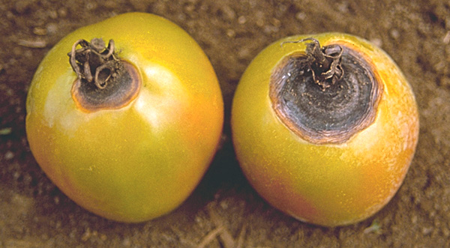
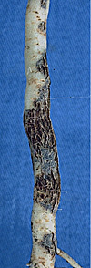
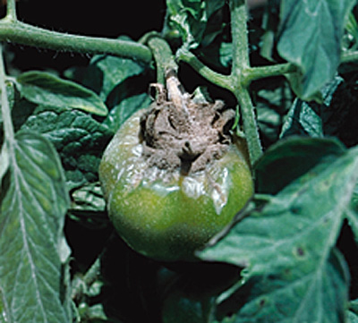
Plant Diseases Caused By Fungi May be Controlled Using A Fungicide
Early Blight
Fungicides vary depending on the disease compromising the plant and timing of infection
Powdery Mildew
Corky Root Rot
Grey Mold
Notes:
In these photos you can see just a few tomato diseases caused by fungi. Just like all living organisms plants are susceptible to infection. They are susceptible to diseases and there are fungicides available to treat plants if they should become infected with an illness. Diseases caused by fungi will not only cause damage during a plant’s growth cycle, but can also cause spoilage after harvest.
There are many pesticides available – both organic and conventional - a farmer may use if a crop becomes infested. Farmers are trained to recognize various diseases caused by fungi so they can accurately treat the pest by choosing the right fungicide and apply it at the correct rate. Fungicides are most effective when applied before the disease occurs or at first appearance of infection. Farmers often use disease forecasting systems or action thresholds, when these are available, to ensure fungicides are applied when needed and to avoid the expense and possible environmental impact of unnecessary applications.
Farmers also use prevention tools such as crop rotation, choosing a disease resistant seed, time of planting and level of fertilization.
(http://www.apsnet.org/edcenter/intropp/topics/Pages/fungicides.aspx)

Slide 13
Organic & Conventional
Farming
Organic
Conventional
Source: https://www.ams.usda.gov/rules-regulations/organic/national-list
Notes:
There is a common misconception that organic farming does not use pesticides. Both organic and conventional farming may use pesticides. Each country has specific guidelines they must follow to become certified organic.
Globally about 1% of agricultural land is organic. Whether you choose to eat organic or conventionally grown food, the look, taste and nutritional value is the same. The difference is in the production methods.
Most of the organic pesticides are derived from natural sources, but there a few synthetic products that may be used in organic production. You can find a full list at www.ecfr.gov – the Electronic Code of Federal Regulations.

Slide 14
Organic and Conventional Farming:
The Highlights
Both conventional and organic farming use modern crop protection products.
Conventional and organic foods are equally nutritious.
Conventional farming produces higher yields.
Farmers need customized agronomic solutions.
Conventional food is just as safe as organic food.
Modern agriculture is sustainable.
Source: Conventional and Organic Ag Fact Sheet – Bayer
Notes:
When it comes to addressing big global challenges like sustainable food production – Bayer understands it’s going to take a lot of tools and approaches. To help in this effort, they focus everyday on helping farmers have a smaller impact on the environment while growing food.
And while we believe that organic practices have a place in helping feed the world’s growing population, it is just one piece of a larger puzzle – one that also includes solutions such as precision farming, agricultural biologicals, and yes, genetic modification.
References as listed in Ag Fact Sheet:
1. University of California, Division of Agriculture and Natural Resources. http://ucnfanews.ucanr.edu/Articles/Feature_Stories/Organic_Herbicdes_-_Do_They_Work/
2. https://med.stanford.edu/news/all-news/2012/09/little-evidence-of-health-benefits-from-organic-foods-study-finds.html
3. Nature. 485,229–232 (10 May 2012). doi:10.1038/nature11069. http://www.nature.com/nature/journal/v485/n7397/full/nature11069.html?foxtrotcallback=true
4. Washington Post (2017). https://www.washingtonpost.com/lifestyle/wellness/a-diet-rich-in-fruits-and-vegetables-outweighs-the-risks-of-pesticides/2017/01/13/f68ed4f6-d780-11e6-9a36-1d296534b31e_story.html
5. Forbes (2018). https://www.forbes.com/sites/stevensavage/2018/04/10/the-inconvenient-truth-about-the-environmental-working-groups-dirty-dozen-list/#3b3a17a8562a

Slide 15
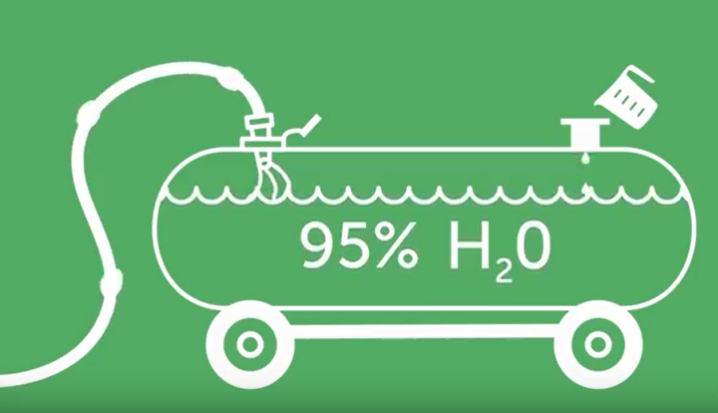
What is in a Tank?
Notes:
Throughout the season you will often see sprayers crossing a field. Depending on the time of year and the type of crop that tank may have an insecticide, herbicide or fungicide. But most of that tank is water – about 95% water. Water is what carries the active ingredients to the plant.
There also have been improvements to the sprayers themselves. Nozzles have been developed to contain drift and make sure that the wind does not carry the spray to any unintended area.

Slide 16
Pesticide Safety
What pesticides can be detected on which foods and at what levels?
Are the detectable residues approved for use in the U.S.?
Are the allowed uses safe for human health and the environment? Are detectable residues below levels that would raise a safety concern?
Farmers receive training and certification as required by their state
Source: https://www.epa.gov/safepestcontrol/food-and-pesticides
Notes:
The responsibility for ensuring that residues of pesticides in foods are not present at levels that will pose a danger to health is shared by FDA, EPA, and the Food Safety and Inspection Service of the U.S. Department of Agriculture. Pesticides of concern include insecticides, fungicides, herbicides, and other agricultural chemicals.
Evaluations continue after a pesticide is in the marketplace. Continuous reevaluation of registered pesticides, combined with strict standards, major improvements in science has led to an overall trend of reduced risk from pesticides.
Most farmers regularly complete pesticide training and certification as required by their state. State Pesticide Safety Education Programs (PSEP) provide information on the safe, precise and effective use of pesticides. Training and certification are done in conjunction with the use of specific labeled instructions that accompany products.
This enables them to use the right tool, at the right time, at the right amount. Farmers understand the risks and benefits to each one of these methods and choose the one that targets their individual needs and challenges.

Slide 17
Assessing Pesticide Safety
Everything, including water, can be hazardous at some level.
It is the exposure (dose) that matters
Source: https://www.epa.gov/pesticide-registration/about-pesticide-registration
Notes:
When it comes to pesticide residue levels, the Environmental Protection Agency (EPA) sets tough limits. In fact, the EPA sets limits at 100 times below levels shown to have no negative effect in animal studies.
The pesticide residues sometimes found in foods are in such small quantities, they are not even remotely close to reaching any level of concern. They’re the equivalent of a few drops of water in an Olympic-sized pool.

Slide 18
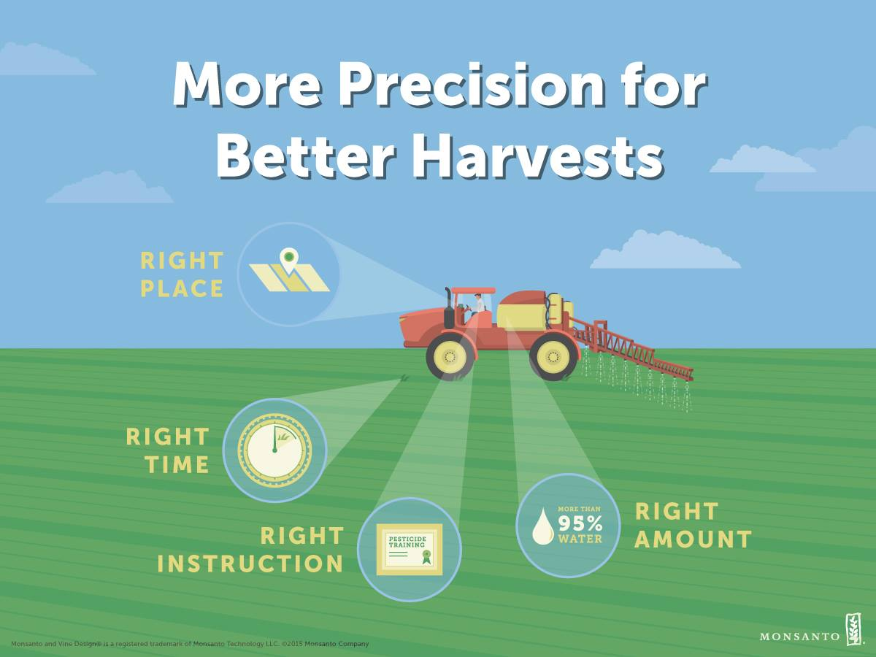
Precision Plays in Important Role When Applying Pesticides
Notes:
Precision is key to pesticide application.
Right Place - Modern Tools like GPS guidance and site specific nozzles help farmers target only the areas on the field that need a pesticide.
Right Time – Pest and weed levels change and farmers adapt to use only what is necessary.
Right Instruction – Most farmers regularly complete training and certification as required by their local area.
Right Amount – It doesn’t take much pesticide to be effective. Most pesticide sprays are more than 95% water.
Pesticides are highly regulated and are reviewed to ensure their safety and efficacy.

Slide 19
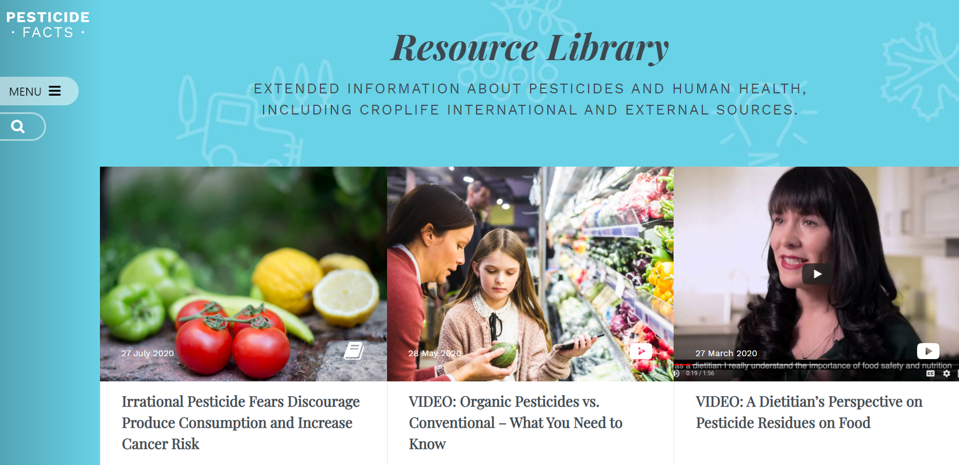
Learn More…
Notes:
If you’d like to know more I encourage you to visit Pesticide Facts (pesticidefacts.org/image is linked) or Crop Life International (croplife.org).
Thank you.

Slide 20
Presenter Notes
Thank you for communicating modern agriculture.
Customize this presentation for your audience. Insert your brand logo, contact information, re-arrange slides, and so forth. Please contact ScientificResources@bayer.com with questions or further context about the slide content.
Looking for ag resources? Bayer Crop Science Resource Library.

