Slide 1
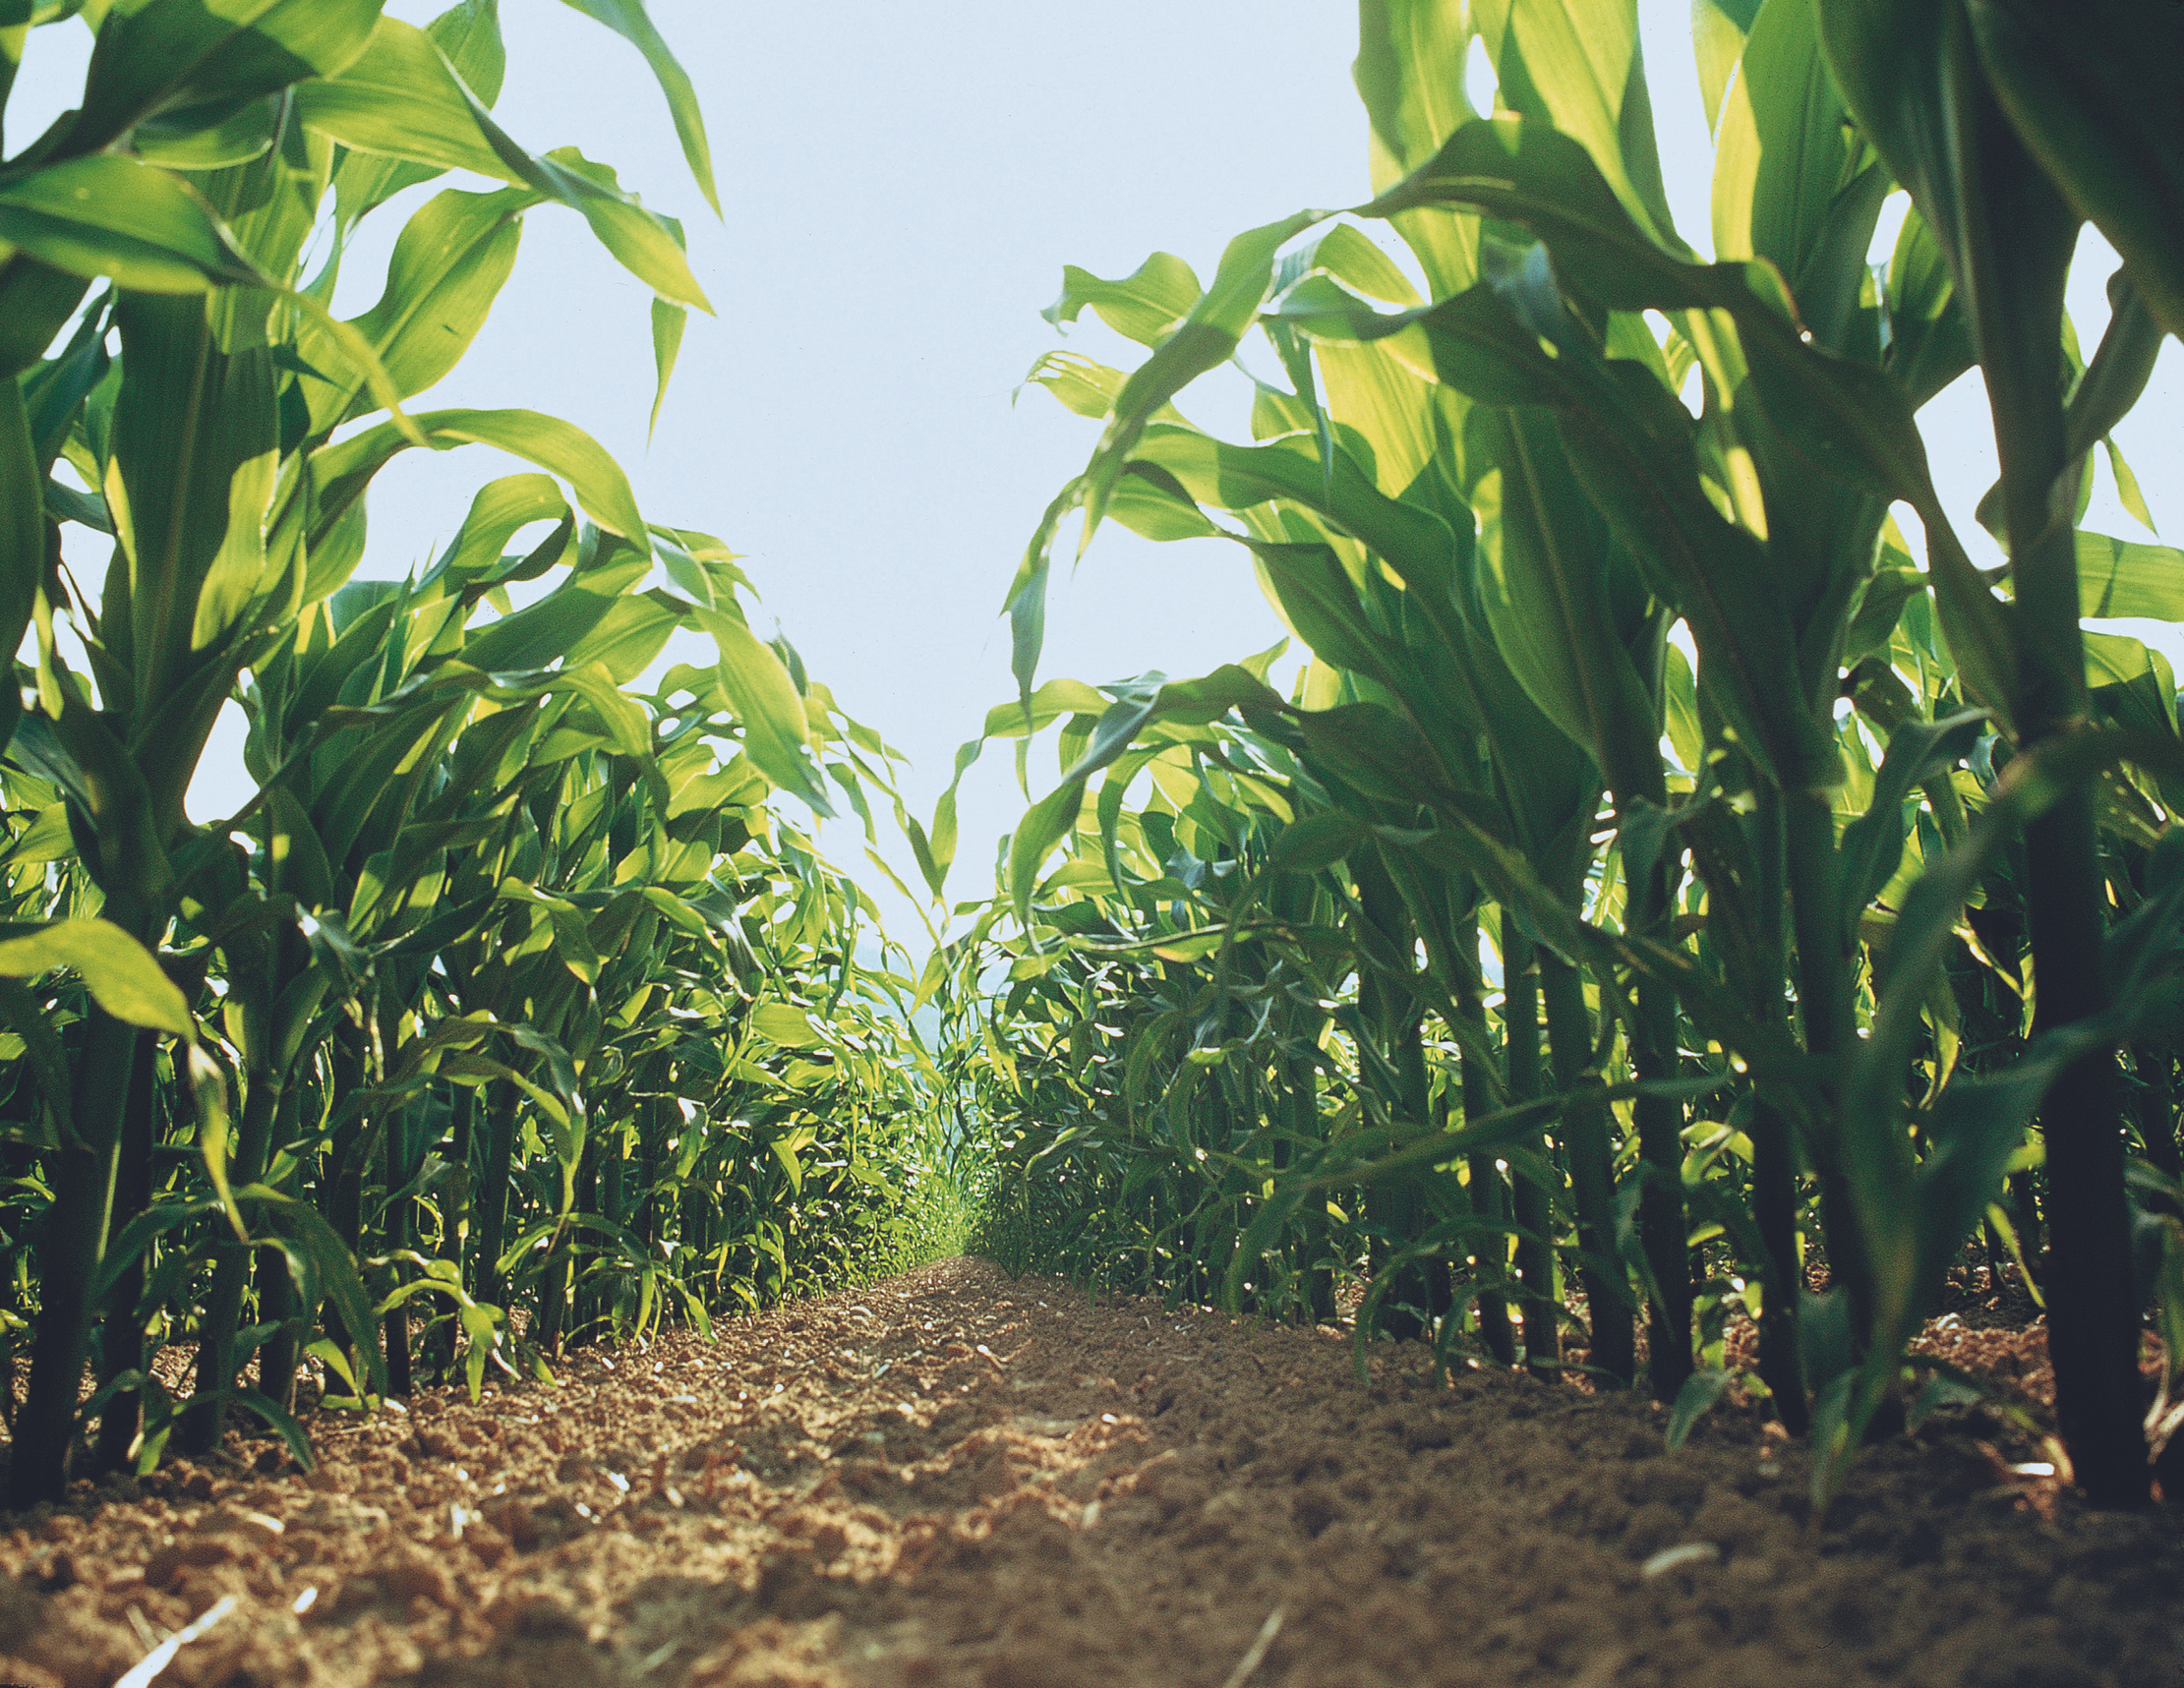
Agriculture
Overview
Modern Farming

Slide 2
Presenter Notes:
Thank you for communicating modern agriculture.
Customize this presentation for your audience. Insert your brand logo, contact information, re-arrange slides, and so forth.
Please contact ScientificResources@bayer.com with questions or further context about the slide content.
Looking for ag resources? Bayer Crop Science Resource Library

Slide 3
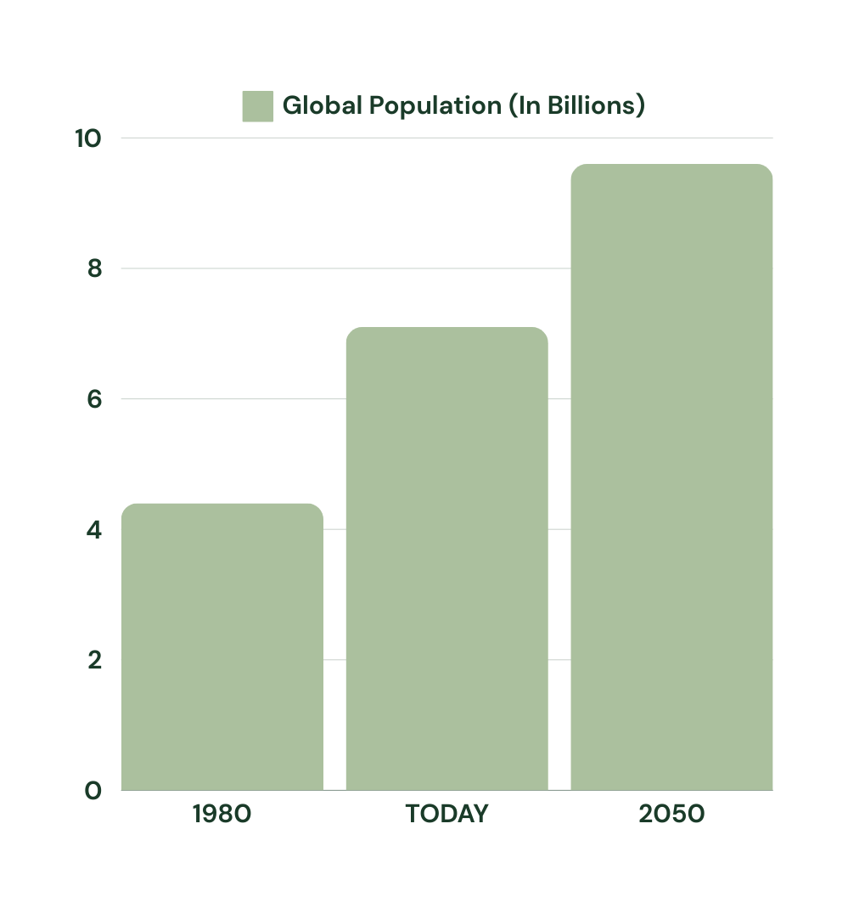
Population Challenges
9.7B+
8B
4.4B
Population growth projections require keeping pace with food production while also preserving productive land.
Source: UN WPP https://www.un.org/development/desa/pd/sites/www.un.org.development.desa.pd/files/wpp2022_summary_of_results.pdf
Notes:
Food security is crucial. Population is expected to reach 9.7B people by 2050. That is an additional 2.5B mouths to feed. This is requiring agriculture to look at ways to produce more, but in a way that is sustainable to preserve the land so it continues to be productive
(data confirmed 7/11/24 - https://esa.un.org/unpd/wpp/Graphs/Probabilistic/POP/TOT/)

Slide 4
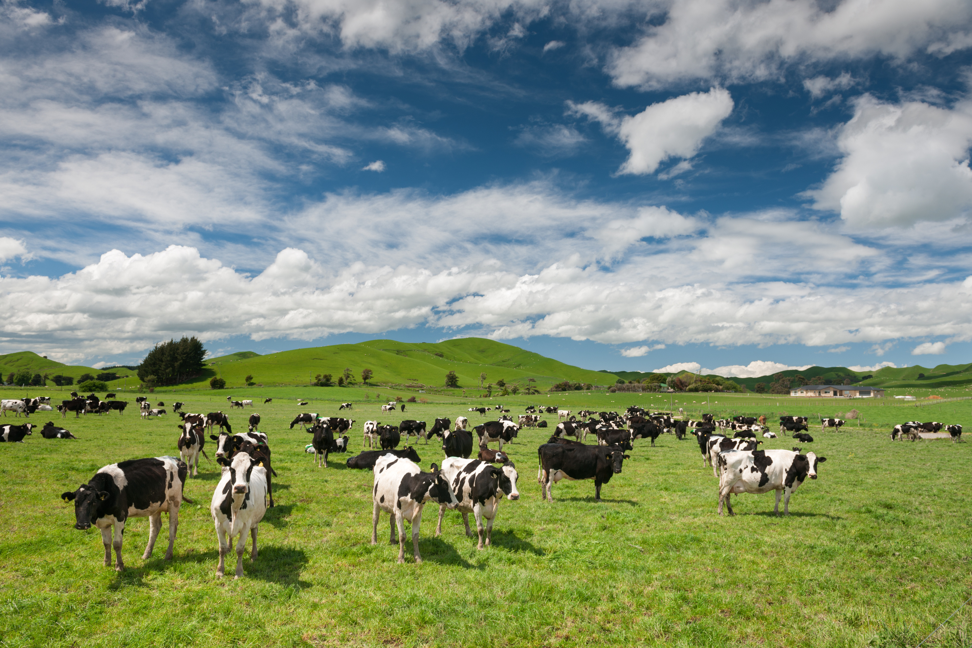
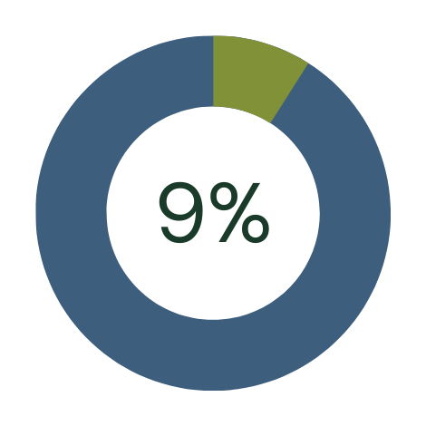
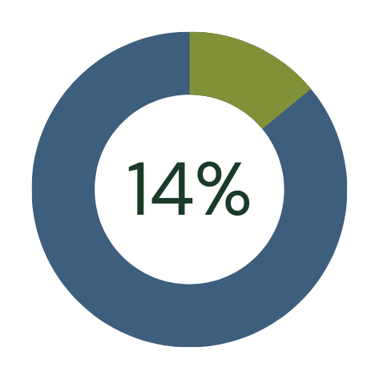
Changing Economies and Diets
A growing global middle class is choosing animal protein – meat, eggs, and dairy – as a larger part of their diet
  GM crops feed more animals while utilizing less land.
1965
2030
Dietary Percentage of Protein
Source: UN FAO Food Balance Sheet, World Health Organization “Global and regional food consumption patterns and trends”
Notes:
As economies improve you will also see a shift to diets adding higher-quality protein. People will add meat, eggs and dairy when they have the extra income to spare. In 1965 9% of diets were protein based, by 2030 we’ll see that move to 14%.

Slide 5

1
<1/3
Limited Farmland
Farmers will need to produce enough food with fewer resources to support our world population
1961
2050
Source: The World Bank, Food and Agriculture Organization of the United Nations (FAO-STAT), Bayer Internal Calculations
Notes:
In the early 1960s one acre supported one person.
By 2050, the global population is projected to increase by 2.5 billion = 9.7 billion people.
With this growth, the demand for food will rise. In order to support this demand, Farmers will need to produce more on the same amount of land.
To feed 9 to 10 billion by 2050, we’ll need to have that land area that was used to feed one person in 1960 - reduced to a third. This will require a great deal of innovation to increase production.

Slide 6
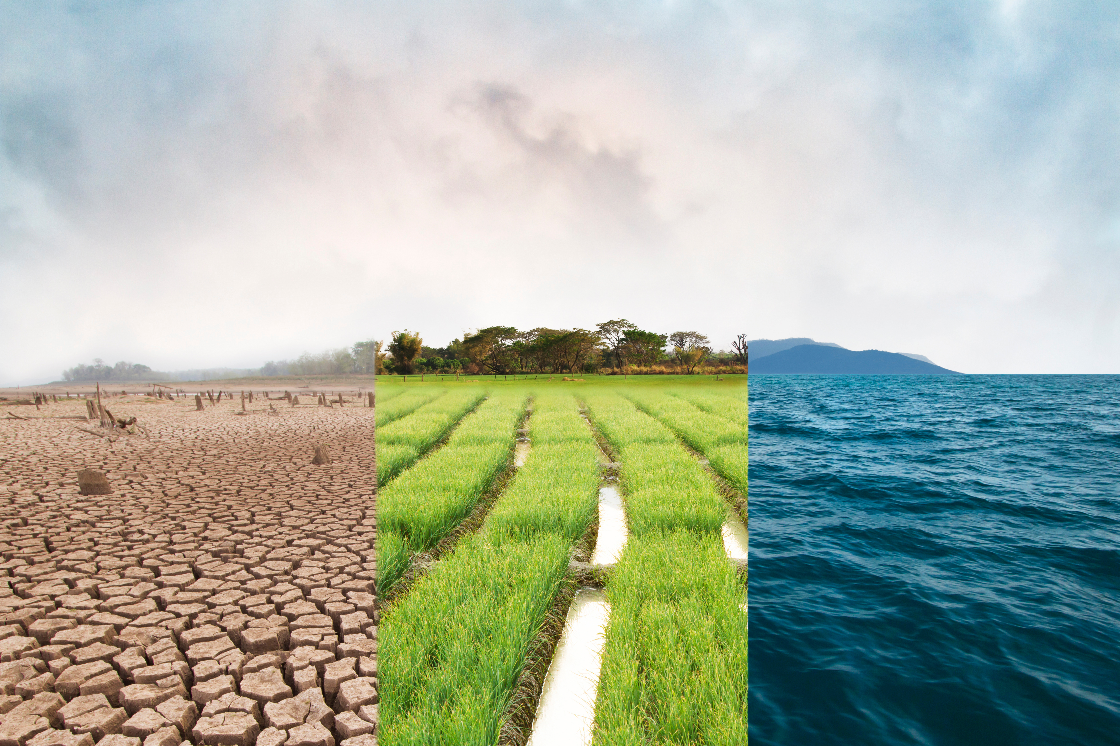
Changing Climate
Farmers are impacted by climate change in many ways:
  Water Availability Issues
  Increasingly Unpredictable and Extreme Weather
  Insect Range Expansion
  Increased Pests and Invasive Species
  Crop Disease Susceptibility
  Planting Zone Shifts
Source: US Fifth National Climate Assessment, 2023https://nca2023.globalchange.gov/#overview-section-3
Notes:
Climate change is a key challenge for farming. Water continues to be an issue across the world. Globally we are seeing more unpredictable and extreme weather which can damage fields. With temperature changes, farmers are seeing an expansion of insects, increased pests and crop diseases. As the warmth moves North, planting zones are shifting.

Slide 7
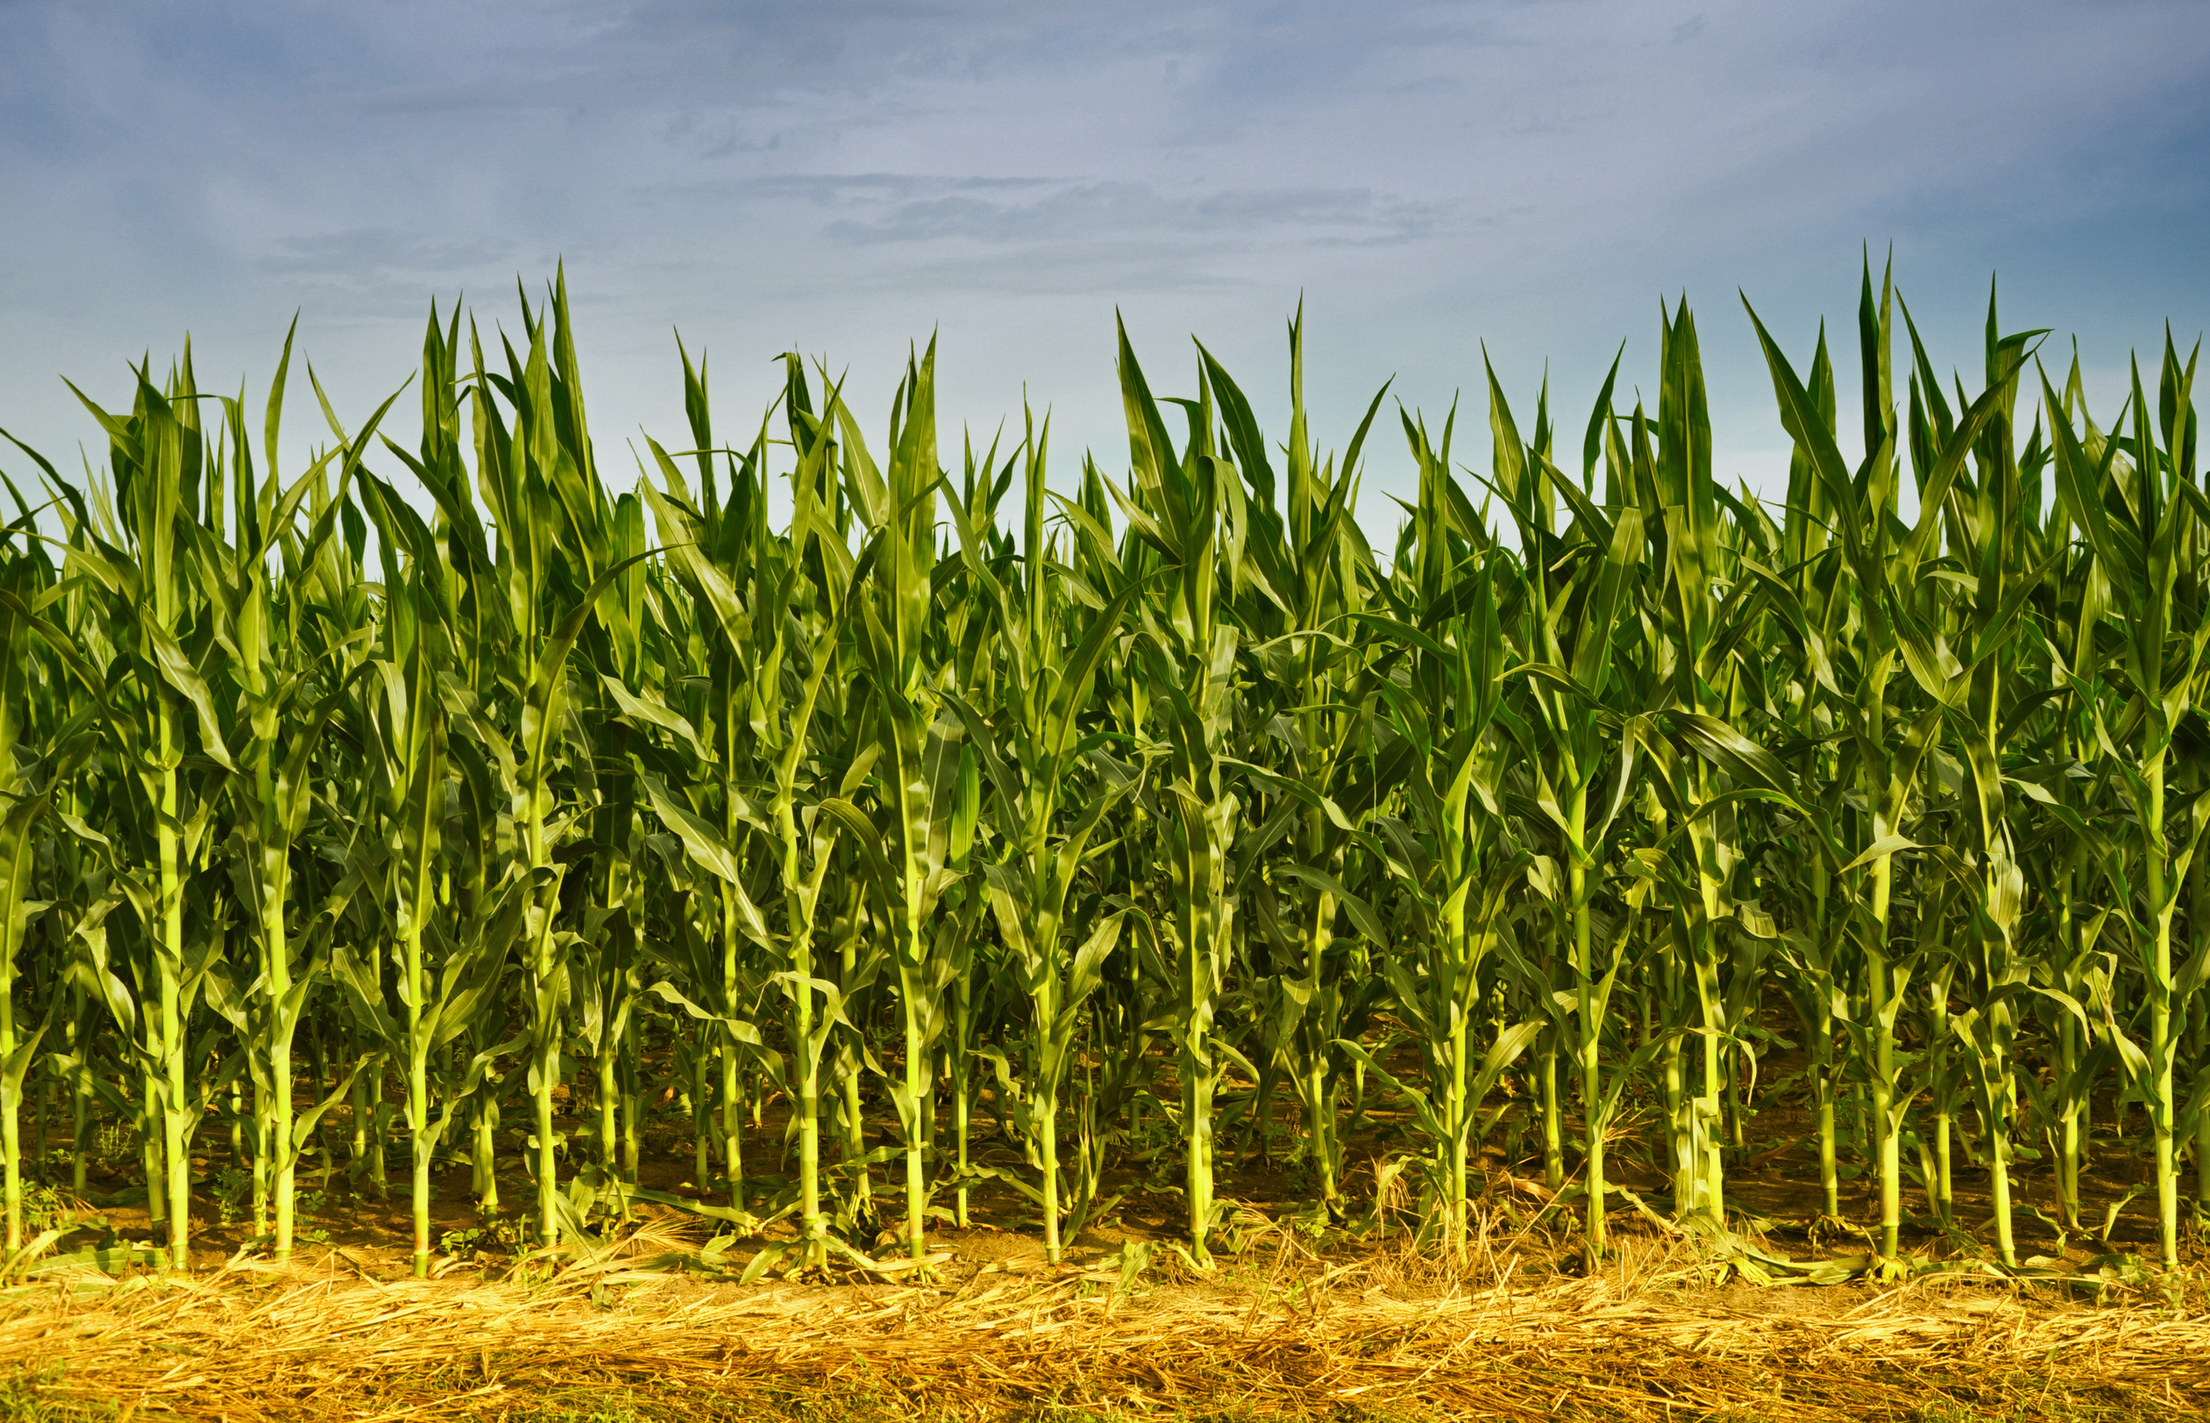
What are the Solutions?
Notes:
These challenges are going to require a great deal of innovation, learning from the past and respecting the future.

Slide 8
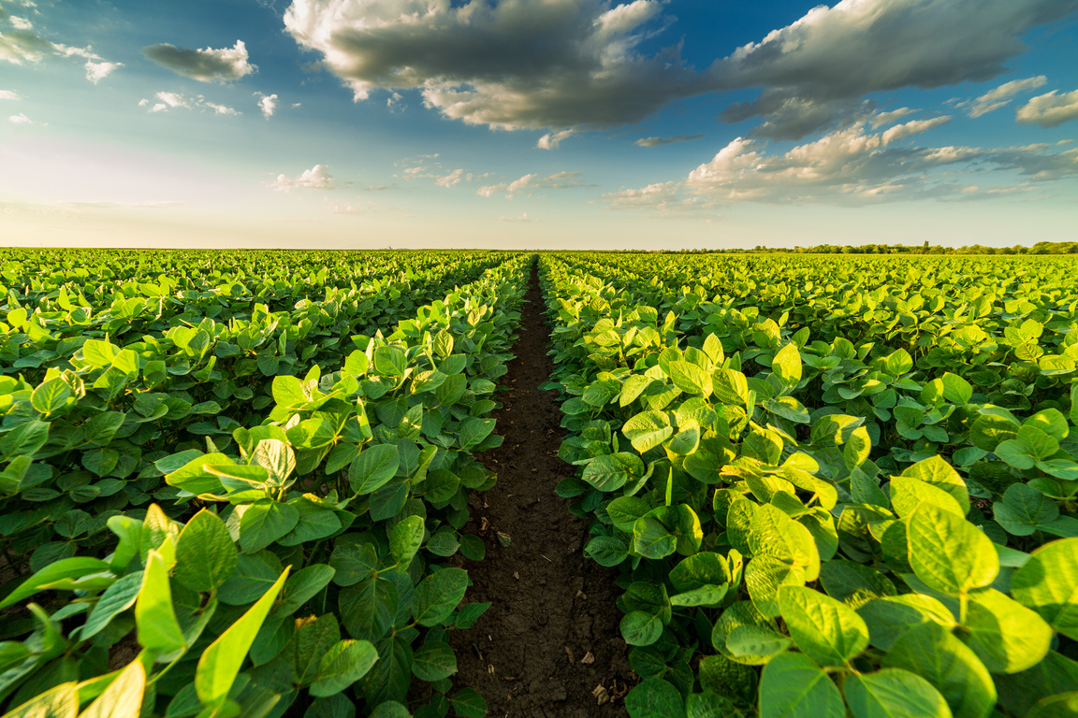
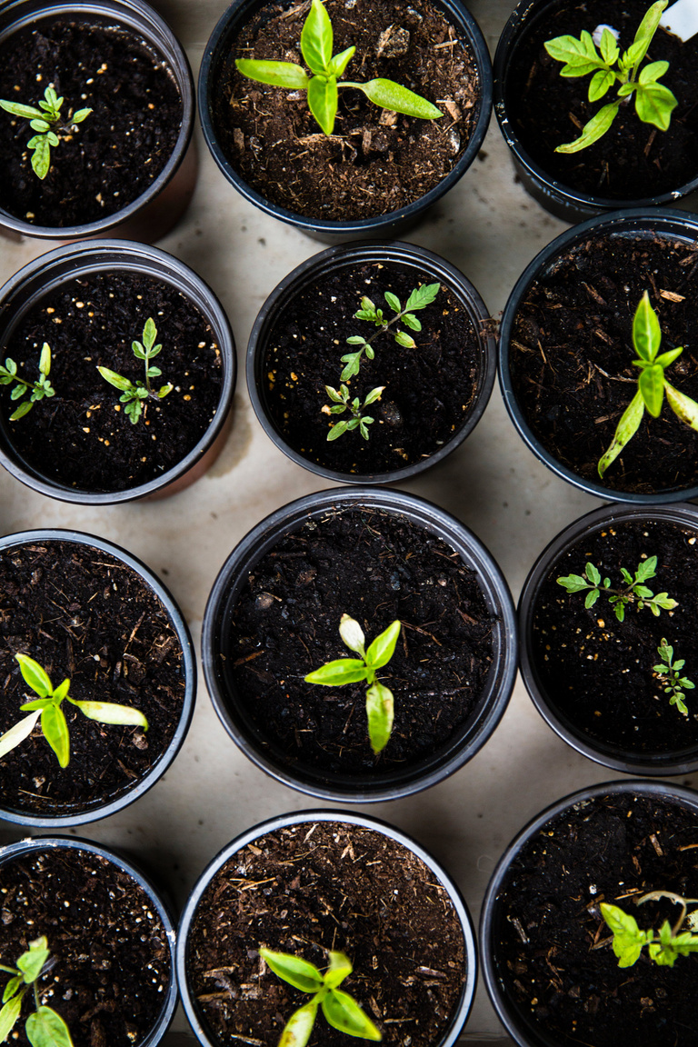
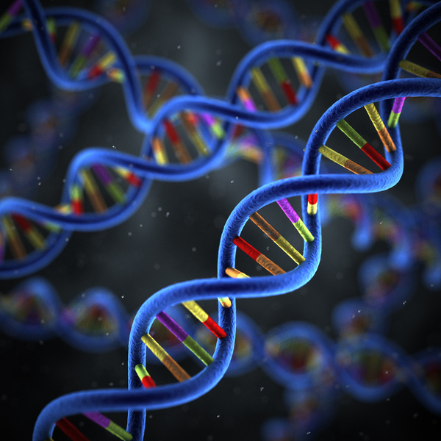
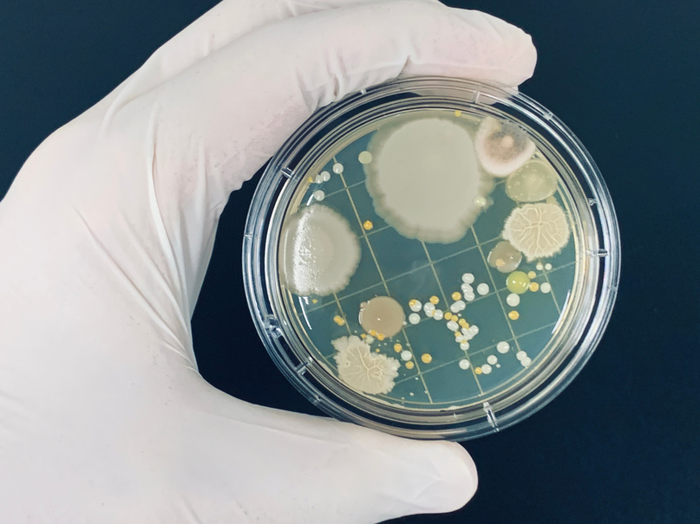
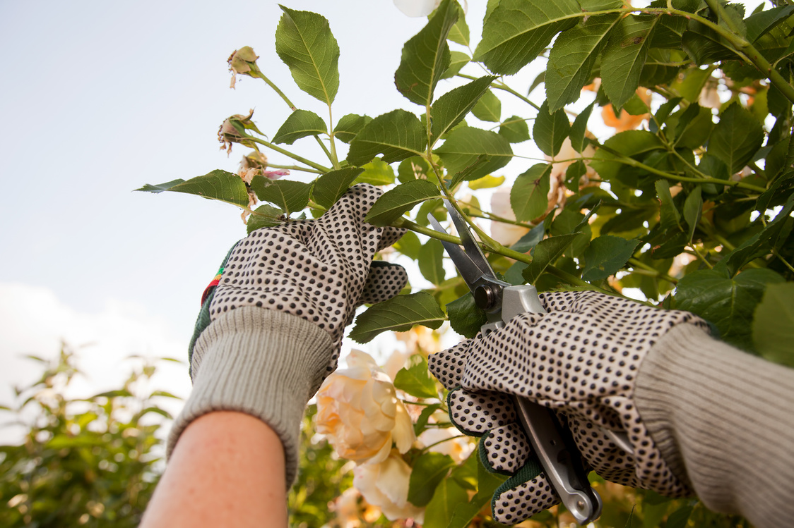
A Broad Range of Solutions for Sustainable Agriculture
Precision
Agriculture
Plant
Breeding
Biotechnology
Microbials
Crop
Protection
Notes:
Bayer, other ag companies, universities, government agencies and others are researching ways to improve agriculture in more sustainable ways. There is potential to combat agriculture challenges in this broad range of solutions like precision agriculture, plant breeding, biotechnology, microbials, and crop protection.

Slide 9
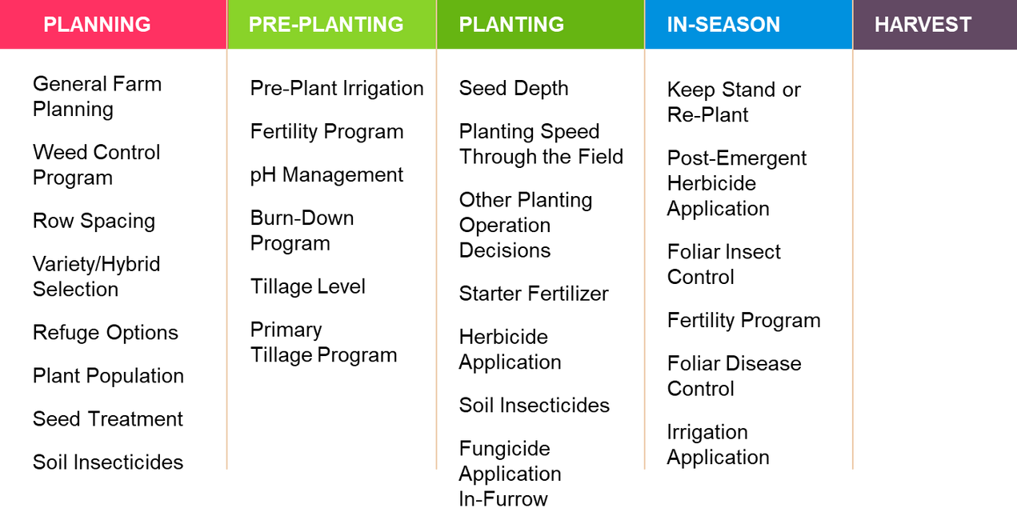
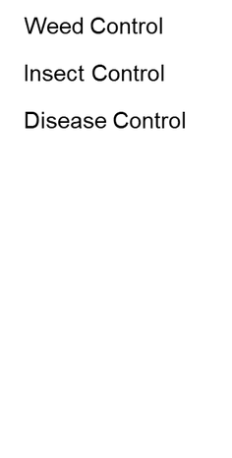

  Precision agriculture is improving data and equipment to give farmers better information to make decisions on their farms and the tools to implement them.
Precision
Agriculture
  Farmers must consider various aspects of planning, pre-planting, planting, in-season, and harvest periods.
Notes:
Precision agriculture is improving technology, data, and equipment to give farmers better information to make decisions on their farms and the tools to implement them. Farmers must consider planning, pre-planting, planting, in-season, and harvest periods, as shown in the table.

Slide 10
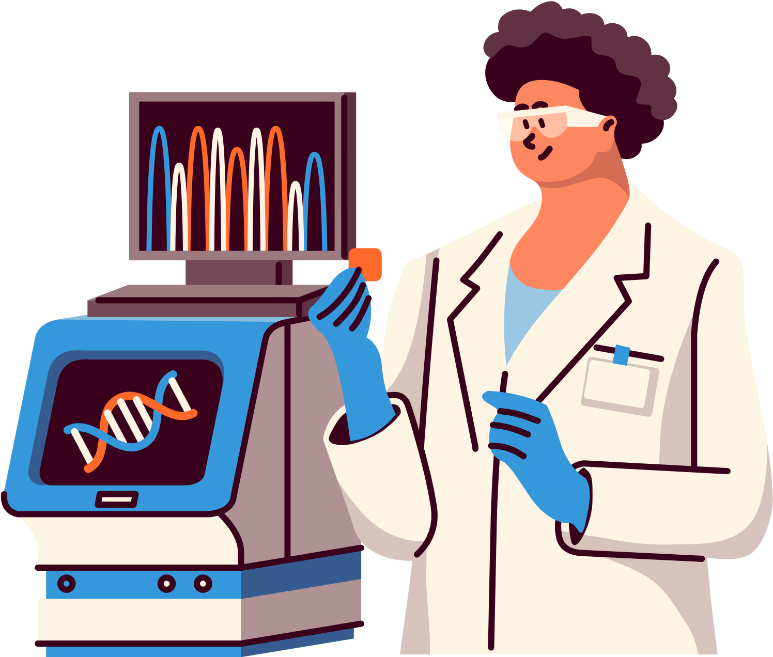
Plant
Breeding
Plant breeding crosses two plants to produce offspring that share the best characteristics of their parent plants.
Today, plants are bred to improve important characteristics. This includes improved agronomic performance to more consumer-facing qualities, like size, taste, or color.
Notes:
Plant breeding is the oldest method of improving agriculture, but there are ways that are used to improve this process to ensure that there are many tools for farmers to use on their farm.

Slide 11

  Biotechnology is the process used in the creation of a GMO.
  There are instances where plant breeding cannot solve an issue on a farm, so this is one way to empower the plant to be more productive by mitigating risks.
Biotechnology
Notes:
Biotechnology is the process of creating a GMO. There are instances where plant breeding cannot solve an issue on a farm, so this is one way to empower the plant to be more productive by mitigating risks.

Slide 12
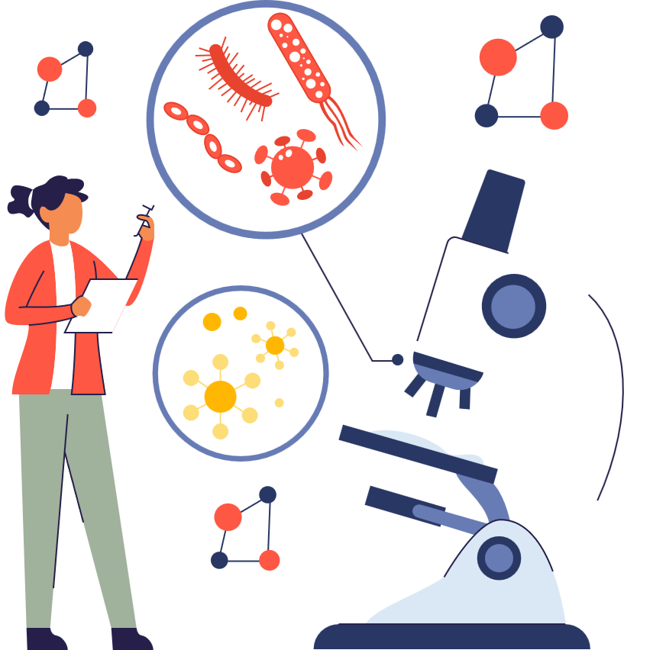

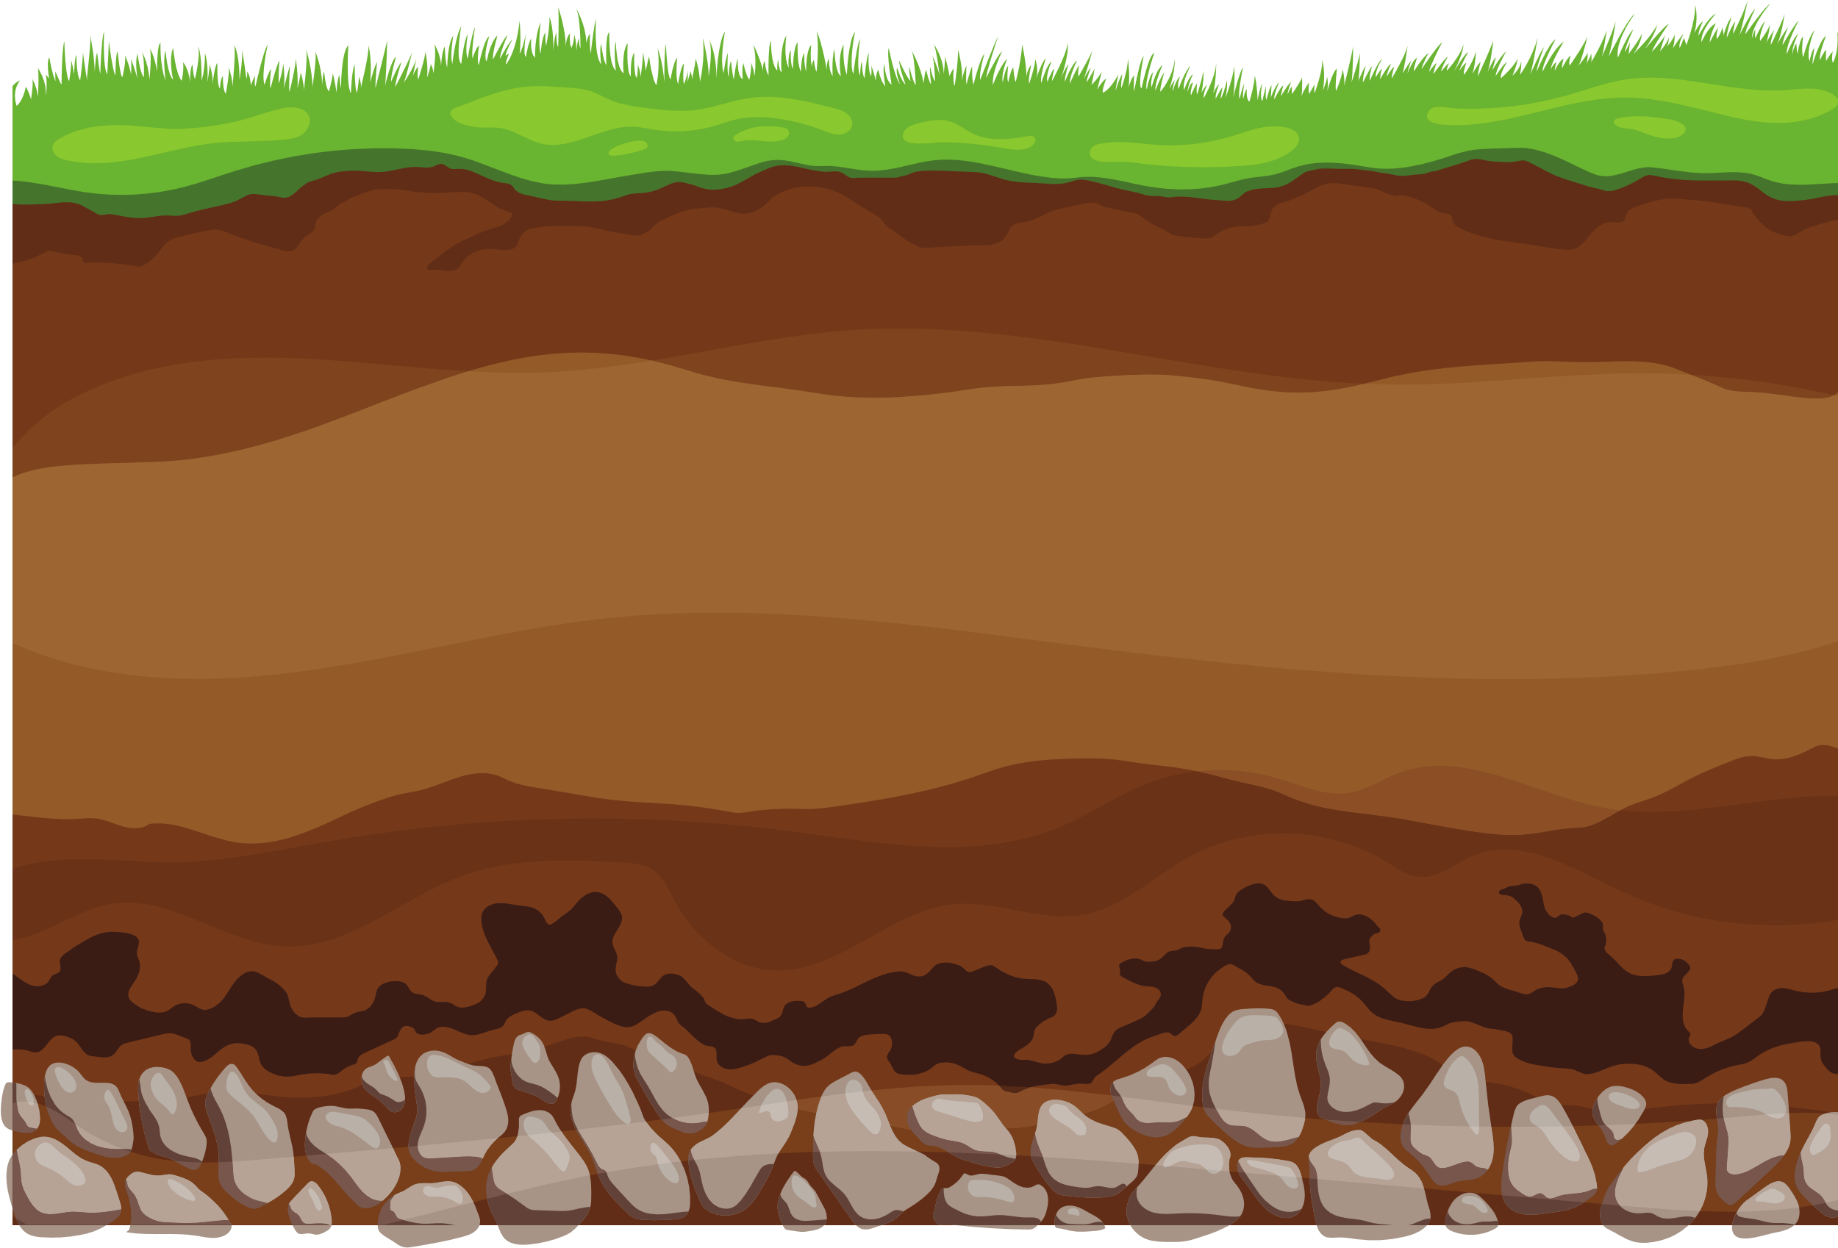
Microbials
• A great way to think about microbials is probiotics for plants. Beneficial microbes in the soil can make significant improvements in plant health.
Notes:
Microbials in agriculture paly a part in commitments to sustainable farming practices and innovation. Microbials, including beneficial bacteria and fungi, play a crucial role in enhancing soil health, improving crop yields, and promoting plant growth.
A great way to think about microbials is probiotics for plants. Microbes in the soil can make significant improvements in plant health.

Slide 13

Crop
Protection
  At any stage, plants are threatened by weeds, insects and diseases.
  Scientists and farmers look at the issues that might affect future crop growth and develop solutions to protect plant health and minimize environmental impact.
Notes:
Crop protection continues to improve the chemistry space. Scientists and farmers look at the issues that might affect future crop growth and develop solutions to protect plant health and minimize environmental impact.

Slide 14

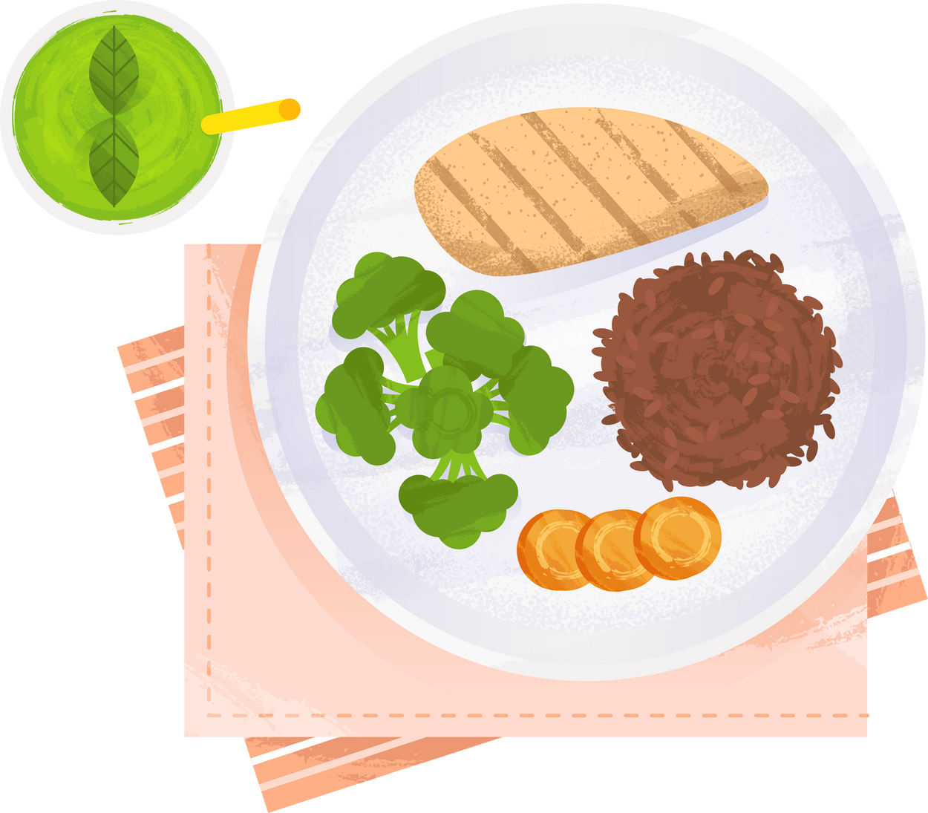
Collaborative Innovation:
Making a balanced meal accessible for everyone and doing it in a sustainable way requires a wide range of ideas and resources.
Notes:
Making a balanced meal accessible for everyone and doing it in a sustainable way requires a wide range of ideas and resources. Everyone has a right to food and no one should go hungry. The solutions we have discussed will ensure that 9.7B people will have enough to eat.

Slide 15
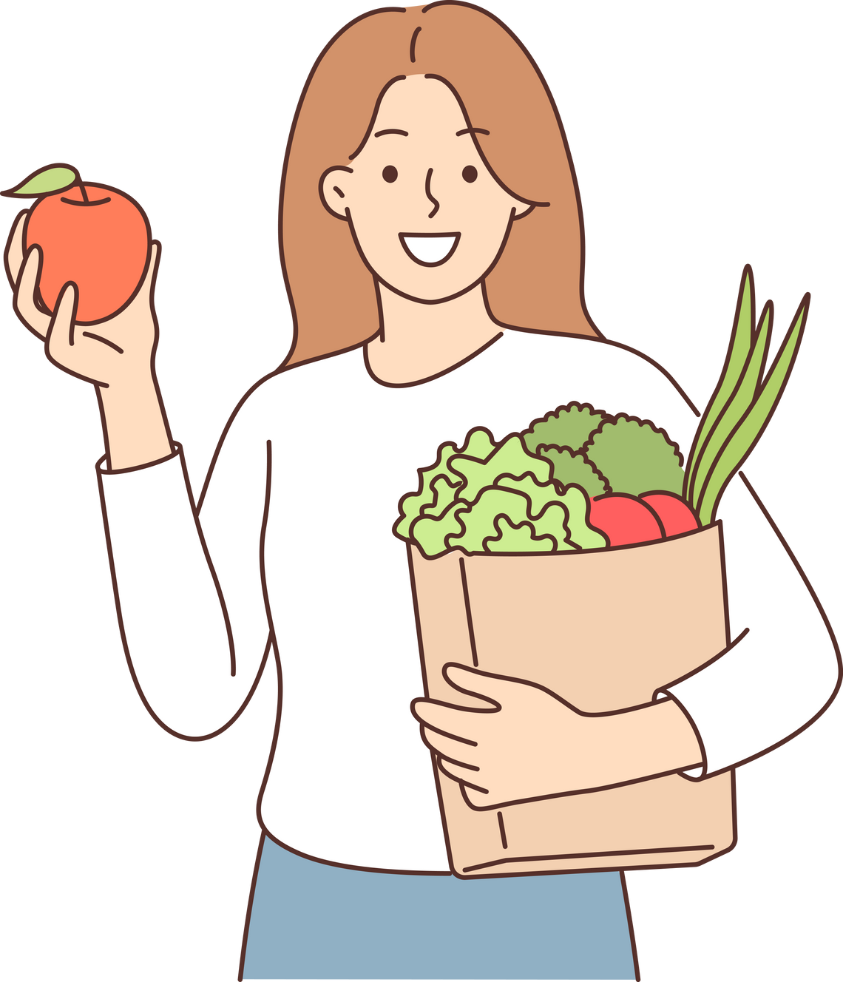

Innovators in agriculture are
responsibly discovering ways to
increase production and quality of crops while reducing inputs and maximizing sustainability.
Notes:
As you can see from these slides, agriculture is complex. Each field for a farmer is unique and driven by the challenges of the land, the crop they are producing, and the method of farming they chose to follow. Farmers need a diverse toolkit of solutions to meet the needs of a growing population, that promotes the health and wellness of individuals, and produces food sustainably.

Slide 16
Thank you for communicating modern agriculture.
Customize this presentation for your audience. Insert your brand logo, contact information, re-arrange slides, and so forth.
Please contact ScientificResources@bayer.com with questions or further context about the slide content.
Looking for ag resources? Bayer Crop Science Resource Library.

