Slide 1



Debt Investor Information
Bayer AG
September 18, 2025
Status: Q2 2025

Slide 2




Cautionary Statements Regarding Forward-Looking Information
This presentation may contain forward-looking statements based on current assumptions
and forecasts made by Bayer management.
Various known and unknown risks, uncertainties and other factors could lead to material differences between the actual future results, financial situation, development or performance of the company and the estimates given here. These factors include those discussed in Bayer’s public reports which are available on the Bayer website at
http://www.bayer.com/
The company assumes no liability whatsoever to update these forward-looking statements or to conform them to future events or developments.

Slide 3




Global Leader in Health & Nutrition:
Uniquely Positioned to Meet Basic Needs of Humankind
g
g
Crop Science
Net Sales
Full Year 2024
as rep⁴
Global Ag Market & Adjacent Spaces expected to double to >€200bn¹ by 2030
Innovative crop system solutions, holding #1 in Seed & Traits with leading Crop Protection Portfolio and digital and carbon solutions
Pharmaceuticals
Attractive market with a current market size of ~ €1.6 trillion² and significant growth opportunities driven by innovation
€46.6bn
~+3%
CAGR⁵
Strong market positions in key therapeutic areas like cardiology, women’s healthcare, oncology, ophthalmology and radiology
Consumer Health
3-5% CAGR CH Global Market with a current market size of ~ €196bn³
Iconic brands with leading market positions in nutritional supplements, allergy, cough and cold, dermatology, pain and cardiovascular risk prevention, and digestive health
Core EPS
Full Year 2024
€5.05
Free Cash Flow
Full Year 2024
€3.1bn
¹ Company estimates ² IQVIA Market Prognosis as of June 2024 ³ Outlook, internal market model in-market sales OTC medicines, data from IQVIA, Nicholas Hall
⁴ As rep = as reported ⁵ CAGR 2020-2024

Slide 4




Global Pressures Underpin Our Mission and the Need for Innovation
PHARMACEUTICALS • CONSUMER HEALTH • CROP SCIENCE
PHARMACEUTICALS • CONSUMER HEALTH • CROP SCIENCE
AGING POPULATION
GROWING POPULATION
PRESSURE ON ECOSYSTEMS
People 60+ more than doubling¹
-20%
Megatrends
through
2050
+2.2bn
+50%
-17%
People ¹
more food and feed required to meet growing demand ²
Harvest losses from climate change ³
Significant loss in arable land per capita ⁴
>20% of total population ¹
Our
Mission
////////////
Health for All, Hunger for None.
Pharmaceuticals
Consumer Health
Crop Science
Our
divisional Vision
Treat the Untreatable.
Cure Disease.
Offer Hope.
Help over 1bn People to
Live Healthier Lives with most
Trusted Self-Care Solutions.
Produce 50% More.
Restore Nature.
Scale Regenerative Ag.
¹ UNDESA 2017 (United Nations Department of Economic and Social Affairs, Population Division (2017). World Population Prospects: The 2017 Revision)
² FAO 2017, (FAO Global Perspective Studies)
³ Nelson et. al, (2014); FAO 2016 “Climate change and food security”
⁴ FAOSTAT (accessed Oct 30, 2018) for 1961-2016 data on land, FAO 2012 for 2030 and 2050 data on land, and UNDEDA 2017: World Population Prospects for world population data

Slide 5

Our 2030 Sustainability Targets¹ Positively Contribute to Today’s Pressing Challenges
Help more PEOPLE thrive
g
Decrease ECOLOGICAL footprint
Food Security:
Support 100m smallholder farmers in LMICs²
Climate neutrality⁴ in own operations
+ reduced emissions in our supply chain
  42% reduction target⁵ for Scope 1 & 2
  12.3% reduction target⁵ for relevant Scope 3 categories
Access to Health:
Support 100m people in underserved³ communities with self care interventions
Increase availability and affordability of our innovative pharma products in LMICs²
  Net Zero emission target by 2050 or earlier
-30 % environmental impact of our global crop protection portfolio per hectare⁷
Enable our farming customers to reduce their on-field GHG emissions by 30% per mass unit of crop produced⁷
Women’s Empowerment:
Fulfill the need of 100m women in LMICs² for modern contraception
Achieve gender balance at all managerial levels
Improving water use per kg of crop by 25%
Transition all Consumer Health products to 100% recycle-ready packaging⁸
¹ The respective target year is 2030 unless specified otherwise; ² LMIC: low and middle income countries - all countries included in the World Bank list as per 1 July 2019; ³ Underserved: economically or medically; ⁴ By 2030, the remaining greenhouse gas emissions of our own operations will be fully offset by purchasing certificates from verified climate protection projects, especially in the areas of forest conservation and agriculture; ⁵ By 2029 from a 2019 base year; ⁶ Against a 2014-2018 average baseline; ⁷ compared to the overall base year emission intensity. This applies to the highest greenhouse gas emitting crop systems in the regions Bayer serves with its products; ⁸ applies to primary, secondary and tertiary packaging, where safety permits and regulations allow

Slide 6











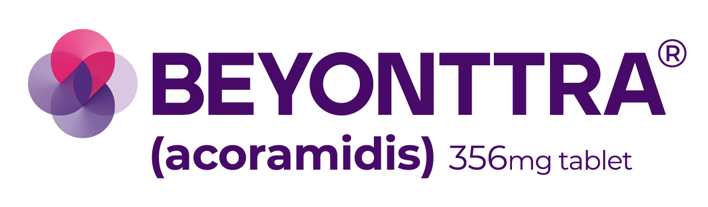









Innovation is an integral part of Bayer’s DNA
>€5bn
R&D investments per year
  Advancing 10 blockbusters
Key Recent Product Launches:
CROP
SCIENCE
>485 new seed products and nearly >230 crop protection registrations in 2024
  Fox Supra (Indiflin®) ²
Key Current Launch Products:
Upcoming Launch Products:
Leading Technology Platforms
PHARMA
Elinzanetant²
Asundexian
1
CONSUMER
HEALTH
Iconic Brands
Our Strategic Unit investing in start-up companies in health and nutrition
¹ Exclusive commercialization rights acquired for EU markets from BridgeBio ² Approved under the brand name LynkuetTM in the UK and Canada in July 2025

Slide 7

2024: Group Performance
Net Sales | 47.6 | 46.6 | +1% cpa (-2% rep) | Currency headwind of ~€1.3bn
EBITDA before special items | 11.7 | 10.1 | -14% | Lower Crop Science and Reconciliation result; currency headwind of ~€0.6bn
Core EPS (in €) | 6.39 | 5.05 | -21% | Lower EBITDA before special items; currency headwind of ~€0.40
Free Cash Flow | 1.3 | 3.1 | +137% | Less litigation related payments and lower incentive payouts; progress on inventory
Net Financial Debt | 34.5 | 32.6 | -6% | Prioritized cash usage for debt reduction
in €bn
FY 2023
FY 2024
∆% yoy
cpa = currency and portfolio adjusted, rep = as reported, core EPS = core earnings per share (cont. operations)

Slide 8
Bayer Key Financials in 2024
EBITDA before Special Items in €bn
Capital Expenditures in €bn
Research & Development Expenses in €bn
Free Cash Flow in €bn
Net Financial Debt in €bn

Slide 9
Outlook 2025: Group Outlook Upgraded at Constant
Currencies – Material FX Headwinds Expected
Previous
FY 2025
Outlook
at constant FX¹
Updated
FY 2025
Outlook
at constant FX¹
Net Sales | 45.0 to 47.0 -3% to +1%³ | 46.0 to 48.0 -1% to +3%³ | ~-2.0 ~ -4%pts
EBITDA before special items | 9.5 to 10.0 -6% to -1% | 9.7 to 10.2 -4% to +1% | ~-0.5 ~ -5%pts
Core EPS (in €) | 4.50 to 5.00 | 4.80 to 5.30 | ~-0.35
Free Cash Flow | 1.5 to 2.5 | 1.5 to 2.5 | ~-0.2
Net Financial Debt | 31.0 to 32.0 | 31.0 to 32.0 | ~-1.2
Updated
Estimated
FX Impact²
in €bn
¹Reflects our 2025 outlook at the average actual currencies for 2024; ²Estimated FX impact: Actual HY1 FX impact plus for remainder of the year FX assumptions based on month-end June 2025 spot rates (1 EUR=) 1.17 USD, 6.43 BRL, 8.40 CNY, 1,393 ARS, 46.65 TRY. Impact is calculated as difference to constant currencies. ³Currency and portfolio adjusted growth; excludes portfolio effect of ~€+0.2bn driven by Natsana acquisition (Consumer Health).

Slide 10
Our Three-Year Turnaround
Our Strategic Priorities
Pharma
Growth & Pipeline
Litigation
Cash & Deleveraging
Crop Science
Profitability
Return to sales growth by 2027
Expand margin¹ by 2028
Increase R&D productivity to further revitalize pipeline
Advance strategies to significantly contain litigation
Improve towards single A category rating
Innovate to grow above market
Targeting mid-20s EBITDA margin² by end of 2029
New Operating Model: Dynamic Shared Ownership
Completely embedded in company’s DNA
Growth driven by innovation speed
and customer centricity
~€2bn organizational savings by end of 2026³
¹ EBITDA margin before special items; ² EBITDA margin before special items, incl. Glyphosate; ³ Total annual organizational savings relative to FY2023 base

Slide 11




Our New Operating Model is Key Enabler to Achieve our Ambitions
Financial impact of our Dynamic Shared Ownership to be realized in stages
Sustainable Cost EFFICIENCIES
GROWTH through Customer Centricity
GROWTH through Innovation Speed
// Elimination of roles, processes and activities not focused on our mission
// Reduction of management layers
// Self-managed customer-
and product teams with much greater autonomy
// Faster response to customer needs
// Increased speed to market due to shorter innovation cycles and faster decision-making
// More dynamic resource flow to highest-impact priorities
Targeted financial implications
€2bn in sustainable organizational savings
by end of 2026

Slide 12


Improve Cash Generation and Prioritize
Capital Allocation to Achieve a Step Down in Debt
Organic
Investments
(before Free Cash Flow)
Cash Generation
Cash
Usage
Minimum Dividend
Ongoing and
New Launches
DRIVING OPERATIONAL PERFORMANCE
and
STRENGTHEN CASH FLOW
DEBT
REDUCTION
Improve Towards
Single A
Category Rating
Focused R&D
Investments
Drive profitable growth
Balance sheet efficiency
Focused
CAPEX Spend
(incl. BD&L¹)
Limited Divestments
Limited Acquisitions²
¹ Business Development & Licensing ² Including milestone payments for already announced acquisitions and others

Slide 13
Bayer Pursues a Conservative Financial Policy…
Financing Instruments
Centralized Financial
Management
Optimization of
Capital Structure
// Syndicated credit facilities
  Key objectives
  Ensure liquidity and creditworthiness
  Long term ambition of investment grade rating towards A category
  Sustained increase in enterprise value
// Global Commercial Paper program
Strict Financial Guidelines
and Global Governance
// Senior bonds in different currencies
Financial Risk
Management
// Hybrid bonds
// Equity-linked instruments
  Prudent debt management with excellent access to diverse sources of liquidity

Slide 14
… and is Ambitious to Improve Its current Investment Grade Ratings towards the "A" Category
Development of Ratings and Leverage¹
Schering
Monsanto
Merck OTC
Proven track record of
disciplined deleveraging
(Net Financial Debt + Pensions – 50% of Hybrid Volume) / reported EBITDA before special items
Agency | Long Term Rating over time
S&P | A | BBB+ | A- |  |  | BBB
Moody’s | A3 |  |  |  |  | Baa1 |  | Baa2
Fitch² | BBB+ |  | A- | A- | A | A- | BBB+ |  |  | BBB
Agency | LT-Rating | Outlook | ST-Rating
S&P | BBB | Negative | A-2
Moody’s | Baa2 | Negative | P-2
Fitch | BBB | Stable | F2
¹ Figures as reported in the respective year’s annual report without restatements
² Solicited since 2018

Slide 15
Bayer’s Maturity Profile is Well Balanced
Bond Maturity Profile (€bn)
as of June 30, 2025¹
Currency Exposure incl. Derivatives
as of June 30, 2025²
€33.3bn
Net Financial Debt
¹ Converted at quarter-end FX rate EURUSD 1.17 and EURCNY 8.40; Not-included: CNY2.0bn Panda Bonds (CNY1.0bn maturing in 2028 and CNY1.0bn maturing in 2030) issued in July 2025
² Based on quarter-end FX rates

Slide 16
Overview of Bayer‘s Funding Structure
Net Financial Debt¹
 |  | Jun. 30, 2024 |  | Dec. 31, 2024 |  | Jun. 30, 2025
 |  | EUR million |  | EUR million |  | EUR million
Bonds and notes / promissory notes |  | 41,794 |  | 38,226 |  | 34,794
of which hybrid bonds² |  | 4,880 |  | 4,600 |  | 4,519
Liabilities to banks³ |  | 1,577 |  | 1,223 |  | 1,258
Lease Liabilities |  | 1,247 |  | 1,248 |  | 1,162
Liabilities from derivatives⁴ |  | 89 |  | 67 |  | 245
Other financial liabilities |  | 1,871 |  | 47 |  | 968
Receivables from derivatives⁴ |  | (179) |  | (262) |  | (106)
Financial debt |  | 46,399 |  | 40,549 |  | 38,321
Cash and cash equivalents |  | (3,888) |  | (6,191) |  | (4,557)
Current financial assets⁵ |  | (5,751) |  | (1,732) |  | (490)
Net financial debt |  | 36,760 |  | 32,626 |  | 33,274
¹ For definition see Annual Report 2024, A 2.3 “Alternative Performance Measures Used by the Bayer Group.”
² Classified as debt according to IFRS
³ Including both financial and nonfinancial liabilities
⁴ Including the market values of interest-rate and currency hedges of recorded transactions
⁵ Including short-term receivables with maturities between 3 and 12 months outstanding from banks and other companies, financial investments in debt and equity instruments that were recorded as current on first-time recognition
Nominal Volume of Major Instruments (bn)
as of June 30, 2025
Net Financial Debt¹
  EUR 13.6 Senior EUR Bonds
  USD 19.4 Senior USD Bonds
  CNY 4.0 Senior CNY Bonds
  EUR 4.6 Hybrid EUR Bonds
  EUR 5.0 Further undrawn Source of Liquidity: Syndicated Loan Facility

Slide 17
Short- and Long-Term Funding Programs
Short-Term Funding: Commercial Paper Program
Long-Term Funding: Debt Issuance Program
Commercial Paper (CP) is a short-term unsecured debt instrument. CP are normally issued at a discount and redeemed at nominal value. It is structured as a SEC regulation’s section 4(a)(2) program so that there are no restrictions related to the use of proceeds.
Under the Debt Issuance Program (DIP) Bayer may from time-to-time issue senior unsecured notes. The notes may be distributed by way of public or private placement and in each case on a syndicated or non-syndicated basis.
Issuer |  | Bayer AG, Germany Bayer Corporation, USA
Guarantor |  | Bayer AG
Term |  | Between 1 and 364 days
Program Amount |  | €5bn or equivalent
Markets |  | U.S. market (USCP) and Euro market (ECP)
Dealer |  | ECP: Barclays, Citigroup, Rabobank, Goldman Sachs, BNP, Credit Agricole USCP: Barclays, Citigroup, J.P. Morgan, Wells Fargo, Bank of New York Mellon, Mitsubishi
Issue and Paying Agent |  | ECP: Deutsche Bank USCP: Deutsche bank
Issuer |  | Bayer AG, Germany
Program Amount |  | €20bn
Term |  | 12 months or more
Dealer |  | Deutsche Bank and further banks as dealer of the day
Arranger |  | Deutsche Bank
Paying Agent |  | Deutsche Bank
Listing |  | Regulated Market of Luxembourg Stock Exchange
Purpose |  | General Corporate Funding Purposes

Slide 18
Back-up Revolving Credit Facility
Syndicated Loan Facility
The multicurrency Syndicated Loan Facility can be used for general corporate purposes and is primarily a back-up line. Thus, it is not intended to be drawn in the course of ordinary business. It was last renewed in December 2024 and the participating banks form Bayer’s global banking group.
Borrower |  | Bayer AG, Germany Bayer Corporation, USA
Total Amount |  | €5.0bn, thereof €1.5bn/$1.5bn Swingline
Signing |  | December 2024
Initial Tenor |  | 5Y + two 1Y extension options
Syndicate Size |  | 23 Banks
Purpose |  | General Corporate Purposes

Slide 19

Main Issuing Entities at Bayer Group
Bayer AG
  Germany
CNY Bonds
Hybrid Bonds
EUR Bonds
Bayer US Finance LLC
  USA
USD Bonds
Bayer Capital Corp. B.V.
  Netherlands
Bayer US Finance II LLC
  USA
USD Bonds
EUR Bonds
Bayer Corp.
  USA
USD Bonds
Monsanto Company
  USA
USD Bonds
Instruments issued or guaranteed by Bayer AG
Indirect Hold through other entities

Slide 20
Hybrid Bonds at Bayer
2019
2022
2023
2024
2025
2026
2027
2028
2029
2030
2031
2054-2083
NC8
Issuance
Nov 19
1st Call Date
Aug 27
Maturity
Nov 79
NC5.5
NC8.5
Issuance
Mar 22
1st ORD²
June 27 & June 30
Maturity
Mar 82
NC5.25
NC8.25
Issuance
Sept 23
1st ORD²
Sept 28 & Sept 31
Maturity
Sept 83
NC5.25
Issuance
Sept 24
1st ORD²
Sept 29
Maturity
Sept 54
Hybrid Bond |  | Coupon ( in%) |  | Outstanding Volume (in bn €) |  | Initial Credit Spread |  | 1st Step-Up |  | 2nd Step-Up
NC8 |  | 3.125 |  | 0.75 |  | 310.8 bps spread + 5Y Swap¹ |  | +25 bps/Nov 32 |  | +75 bps/Nov 47
NC5.5 |  | 4.5 |  | 0.5 |  | 375.1 bps spread + 5Y Swap¹ |  | +25 bps/Sept 32 |  | +75 bps/Sept 47
NC8.5 |  | 5.375 |  | 0.8 |  | 445.8 bps spread + 5Y Swap¹ |  | +25 bps/Sept 35 |  | +75 bps/Sept 50
NC5.25 |  | 6.625 |  | 0.75 |  | 343.2 bps spread + 5Y Swap¹ |  | +25 bps/Dec 33 |  | +75 bps/Dec 48
NC8.25 |  | 7 |  | 1.0 |  | 389.6 bps spread + 5Y Swap¹ |  | +25 bps/Dec 36 |  | +75 bps/Dec 51
NC5.25 |  | 5.5 |  | 0.75 |  | 326.9 bps spread + 5Y Swap¹ |  | +25 bps/Dec 34 |  | +75 bps/Dec 49
¹ Swap is reset every fifth year starting with the first reset date
² Optional Redemption Date

Slide 21
Upcoming Events 2025/2026
Date
^{Wednesday, November 12, 2025} | Q3 2025 Results / Quarterly Statement
^{Wednesday, February 25, 2026} | Q4 2025 Results / Annual Report
^{Friday, April 24, 2026} | ^{Annual Stockholders’ Meeting}
^{Tuesday, May 12, 2026} | Q1 2026 Results / Quarterly Statement
Event/ Publication
Please note that the event calendar might be subject to changes

Slide 22
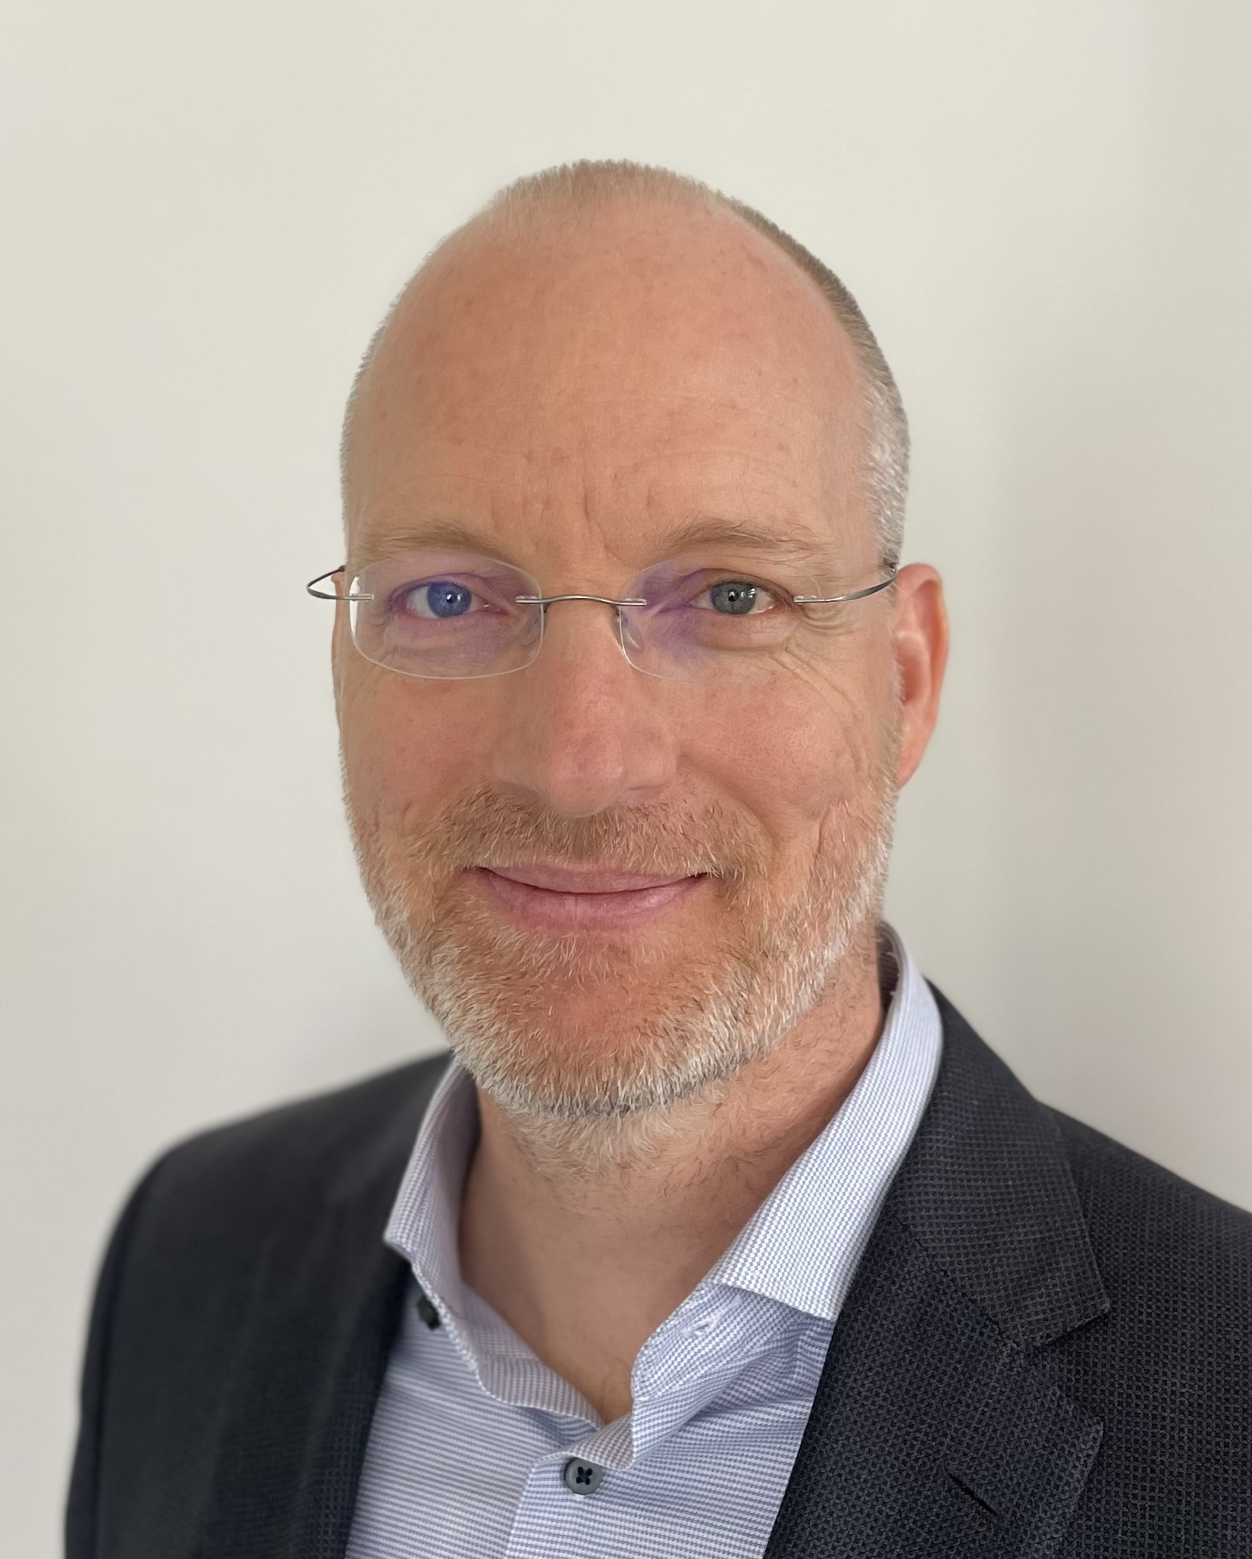
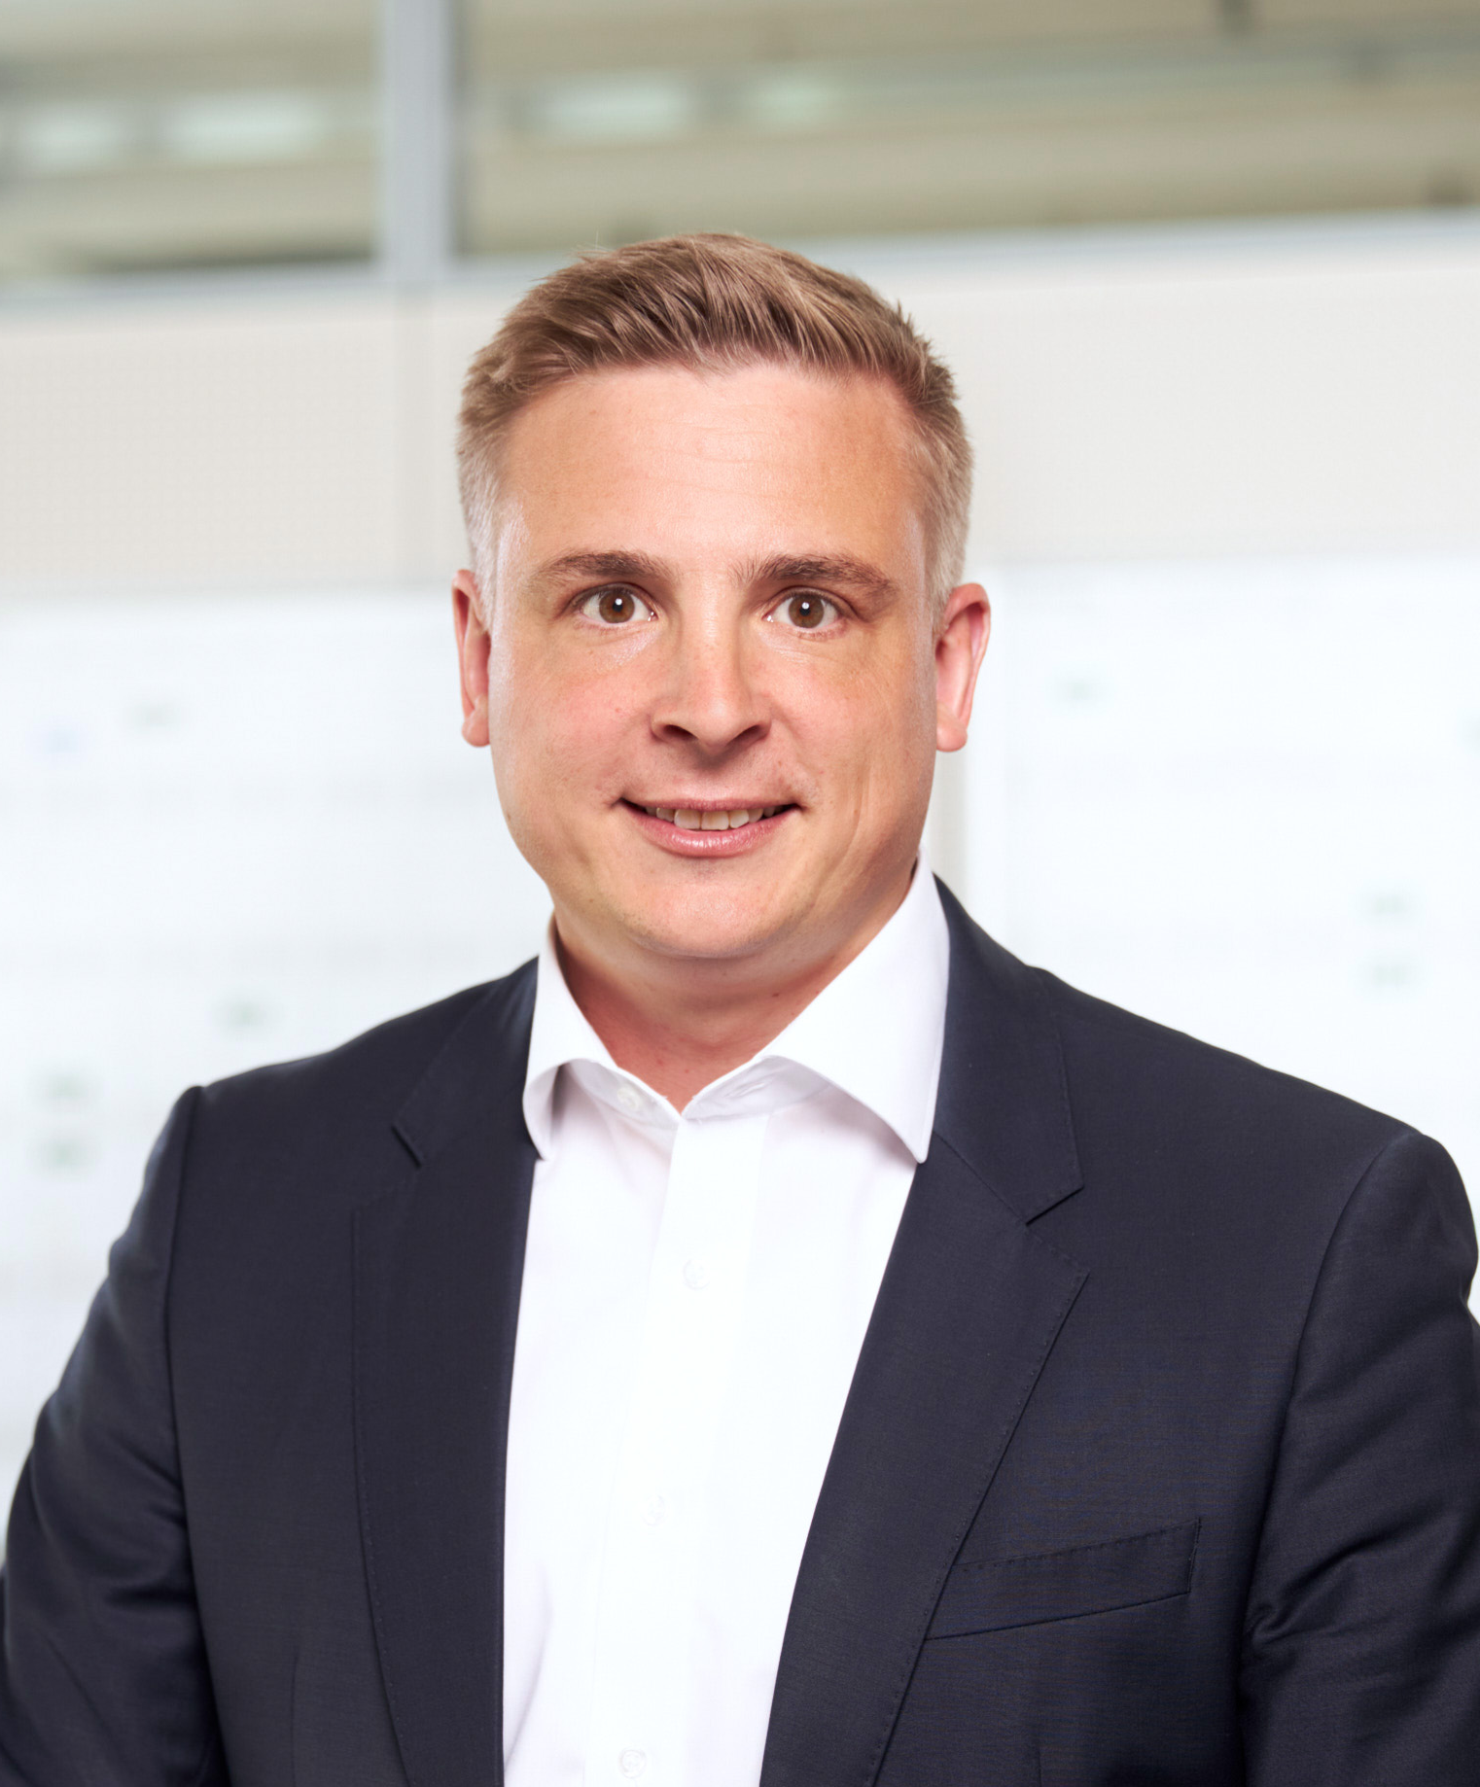
Contacts at Bayer
 | Dr. Sven Vorstius Head of Funding E-Mail: Sven.Vorstius@bayer.com | Building W 11 D-51368 Leverkusen
 | Tobias Feld Investor Relations Officer E-Mail: Tobias.Feld@bayer.com | Building W 11 D-51368 Leverkusen

